Slide 1
Microsoft Azure

Slide 2
Topic 1: Azure Fundamentals
• Introduction to Azure
• Different segments SaaS, PaaS, and IaaS
• Azure Regions and Data Centers
• Understanding of Microsoft Azure portal
• Introduction to all Azure services
• Windows Azure Subscription
• Setting Up a Trial Subscription
Topic 2: Azure Virtual Machines
• Operating System Images Supported
• Virtual Machine instances
• Azure VM types and Pricing
• Types of Provisioning
• Disks & Images
• Virtual Machine management, automation and scripting
• Cloud Service and Resource Model Deployment
• Setting up VM in Availability set using Load Balanced Endpoint
• VM Availability using Availability Sets
Topic 3: Azure Virtual Networks
• Introduction to Azure Virtual Network and Services
• Types of Azure Virtual Network VNET to VNET, point-to-site and site-to-site, Express Route.
• Creating Virtual Networks in Azure
• Azure Subnet and IP ranges

Slide 3
• Endpoints
• Load Balancing Endpoints
• Understanding Network ACL and Network Security Group
• Setting up Private and Public IP
• Hands-on Lab: Create a VET-to-VNET virtual network
• Hands-on Lab: Create a point-to-site virtual network
• Introduction to Azure Traffic Manager
• Available options in Azure Traffic Manager
• Understanding of Deployment Traffic Manager
• Hands-on Lab: Load Balancing using Azure Traffic Manager
Topic 4: Microsoft Azure Storage
• Overview
• Storage Account • Storage Account Replication Techniques
• Protocols and Consistency Model
• Type of Azure Storage Account
• Storage Services Blob, Table, queue, File
• Azure CDN Services, Managed and Unmanaged Disk
• Hands-on Lab: Provisioning Azure Storage services
Topic 5: Implement an Azure Active Directory
• Active Directory Fundamentals
• Implement Azure AD Connect
• Multifactor Authentication
• Add custom domains

Slide 4
• Monitor Azure AD
• Configure single sign-on with SaaS applications
• Users and Groups Provisioning
• Configure federation
• Implement Azure AD integration in web and desktop applications
• Create an Azure AD B2C Directory
• Implement B2B collaboration
• Configure partner users
• Integrate with applications
• Azure AD data sync
• Role-based Access Control
• ADFS and Azure Access Control Service
• Hands-on Lab: Authentication On‐Premise app using Azure AD
• Overview and Available features and Media Services
• Azure Notification Hub Services
Topic 6: Azure SQL Database
• Understanding Database as a service
• Difference between SQL server and Azure SQL
• Advantage and Benefits of SQL database
• Scaling SQL database
• Backup and Performance Options
• Security in Azure SQL
• Pricing Model
• Hands-on Lab: Migrate a database from on premise to SQL Azure

Slide 5
Topic 7: Azure Web Apps
• Understanding Web App tiers
• Understanding of Web Job Pricing , Security, Monitoring
• Resource Group and Web Hosting Plans in the New Preview portal
• Supported language
• Deploying Web App
• Deployment sources
• Hand-on Lab: Create, Deploy, Manager
• Deployment
• Benefits
• Roles in Azure Cloud services
• Web Role and Worker Role
• Understanding Fault Domain and Upgrade Domain
• Deployment pipeline
• Hands-on Lab: Deploying Application package with Azure Cloud Services
Topic 8: Azure Backup and Site Recovery
• Azure Vaults
• Configuring backups
• Data Protection Manager
• Azure Site Recovery and Disaster Recovery
• On Premise Migration using Recovery Services
• Hands-on Lab: Configure a vault and backup a server from on premise to cloud
• On-premise to on premise
• On-premise to Azure

Slide 6
Module 1 Azure Fundamentals
Module Overview
Lesson 1:What is cloud computing
Lesson 2: What is Azure

Slide 7
Lesson 1: What is cloud computing
Overview of cloud computing
Cloud-computing models
Types of cloud services

Slide 8
Cloud Computing Patterns
On and Off
Inactivity
Period
Compute
On and off workloads (e.g. batch job)
Over provisioned capacity is wasted
Time to market can be cumbersome
t
Growing Fast
Compute
Successful services needs to grow/scale
Keeping up with growth is a big IT challenge
Cannot provision hardware fast enough
t
Unpredictable Bursting
Compute
Unexpected/unplanned peak in demand
Sudden spike impacts performance
Cannot over provision for extreme cases
t
Predictable Bursting
Compute
Services with micro seasonality trends
Peaks due to periodic increased demand
IT complexity and wasted capacity
t
Notes:
The cloud computing patterns about why someone would want to shift from on-premises solutions into Microsoft Azure are self-explanatory. Have customers think about the applications that they currently have, to determine if they fit into this picture.
Understand, though, that just because a customer wants elasticity, it does not mean that their app is built for it.

Slide 9
Elasticity-Provision Vs Workload
Cloud provides on-demand, scale out and in, compute, storage and network resources
Provisioning Benefit: Reduced Costs and Improved User Experience
Demand
Provision
Overprovisioned
Under provisioned
Self Provision
Cloud Provisioning
Resource
Resource
Time
Time
Notes:
A hybrid deployment is a way to connect infrastructure and applications between cloud-based resources and existing resources that are not located in the cloud. The most common method of hybrid deployment is between the cloud and existing on-premises infrastructure to extend, and grow, an organization's infrastructure into the cloud while connecting cloud resources to the internal system.

Slide 10
Definition
As per US-National Institute of Standards and Technology (NIST) the definition of Cloud is a model for enabling access to a shared pool of configurable computing resources (e.g., networks, servers, storage, applications, and services) that can be rapidly provisioned and released with minimal management effort or service provider interaction.
5-Characteristics
On-Demand Self- Service
Broad Network Access
3- Service Models
Infrastructure as a Service (IaaS)
Platform as a Service (PaaS)
4- Deployment Models
Private Cloud
Community Cloud
Resource Pooling
Rapid elasticity
Measured Service/Reliability
Software as a Service (SaaS)
Public Cloud
Hybrid Cloud
Notes:
On-demand self-service. A consumer can unilaterally provision computing capabilities, such as server time and network storage, as needed automatically without requiring human interaction with each service provider.
Broad network access. Capabilities are available over the network and accessed through standard mechanisms that promote use by heterogeneous thin or thick client platforms (e.g., mobile phones, tablets, laptops, and workstations).
Resource pooling. The provider’s computing resources are pooled to serve multiple consumers using a multi-tenant model, with different physical and virtual resources dynamically assigned and reassigned according to consumer demand. There is a sense of location independence in that the customer generally has no control or knowledge over the exact location of the provided resources but may be able to specify location at a higher level of abstraction (e.g., country, state, or datacenter). Examples of resources include storage, processing, memory, and network bandwidth.
Rapid elasticity. Capabilities can be elastically provisioned and released, in some cases automatically, to scale rapidly outward and inward commensurate with demand. To the consumer, the capabilities available for provisioning often appear to be unlimited and can be appropriated in any quantity at any time.
Measured service/Utility service / Reliability. Cloud systems automatically control and optimize resource use by leveraging a metering capability1 at some level of abstraction appropriate to the type of service (e.g., storage, processing, bandwidth, and active user accounts). Resource usage can be monitored, controlled, and reported, providing transparency for both the provider and consumer of the utilized service.

Slide 11
Overview of cloud computing
Characteristics of cloud-computing solutions:
On-demand self-service
Broad network access
Resource pooling
Rapid elasticity
Measured service
Advantages of cloud computing:
Access to a broad range of managed services
Minimized or eliminated capital expenses
Lowered operational expenses
Usage-based billing model
Improved agility
Notes:
Infrastructure as a Service (IaaS) Infrastructure as a Service (IaaS) contains the basic building blocks for cloud IT and typically provide access to networking features, computers (virtual or on dedicated hardware), and data storage space. IaaS provides you with the highest level of flexibility and management control over your IT resources and is most similar to existing IT resources that many IT departments and developers are familiar with today.
Platform as a Service (PaaS) Platform as a Service (PaaS) removes the need for your organization to manage the underlying infrastructure (usually hardware and operating systems) and allows you to focus on the deployment and management of your applications. This helps you be more efficient as you don’t need to worry about resource procurement, capacity planning, software maintenance, patching, or any of the other undifferentiated heavy lifting involved in running your application.
Software as a Service (SaaS) Software as a Service (SaaS) provides you with a completed product that is run and managed by the service provider. In most cases, people referring to Software as a Service are referring to end-user applications. With a SaaS offering you do not have to think about how the service is maintained or how the underlying infrastructure is managed; you only need to think about how you will use that particular piece of software. A common example of a SaaS application is web-based email which you can use to send and receive email without having to manage feature additions to the email product or maintain the servers and operating systems that the

Slide 12
Definition
Public Cloud − A service provider makes the clouds available to the general public which is termed as a public cloud. These clouds are accessed through internet by users.
Private Cloud − These clouds are dedicated to a particular organization. That particular organization can use the cloud for storing the company's data, hosting business application, etc.
Hybrid Cloud − When two or more clouds are bound together to offer the advantage of both public and private clouds, they are termed as Hybrid Cloud. Organizations can use private clouds for sensitive application, while public clouds for non-sensitive applications. The hybrid clouds provide flexible, scalable and cost-effective solutions to the organizations.
Community Cloud- A community cloud is a multi-tenant infrastructure that is shared among several organizations from a specific group with common computing concerns.
Private Cloud
Community Cloud
Public Cloud
Hybrid Cloud
4- Deployment Models
Notes:
On-demand self-service. A consumer can unilaterally provision computing capabilities, such as server time and network storage, as needed automatically without requiring human interaction with each service provider.
Broad network access. Capabilities are available over the network and accessed through standard mechanisms that promote use by heterogeneous thin or thick client platforms (e.g., mobile phones, tablets, laptops, and workstations).
Resource pooling. The provider’s computing resources are pooled to serve multiple consumers using a multi-tenant model, with different physical and virtual resources dynamically assigned and reassigned according to consumer demand. There is a sense of location independence in that the customer generally has no control or knowledge over the exact location of the provided resources but may be able to specify location at a higher level of abstraction (e.g., country, state, or datacenter). Examples of resources include storage, processing, memory, and network bandwidth.
Rapid elasticity. Capabilities can be elastically provisioned and released, in some cases automatically, to scale rapidly outward and inward commensurate with demand. To the consumer, the capabilities available for provisioning often appear to be unlimited and can be appropriated in any quantity at any time.
Measured service/Utility service / Reliability. Cloud systems automatically control and optimize resource use by leveraging a metering capability1 at some level of abstraction appropriate to the type of service (e.g., storage, processing, bandwidth, and active user accounts). Resource usage can be monitored, controlled, and reported, providing transparency for both the provider and consumer of the utilized service.

Slide 13


Service Models
Packaged Software
Infrastructure
(as a Service)
Platform
(as a Service)
Software
(as a Service)
Applications
You manage
Applications
Applications
Applications
You manage
Data
Data
Data
Data
Runtime
Runtime
Runtime
Runtime
Middleware
Middleware
Middleware
Managed by vendor
Middleware
You manage
Managed by vendor
O/S
O/S
O/S
O/S
Virtualization
Virtualization
Managed by vendor
Virtualization
Virtualization
Servers
Servers
Servers
Servers
Storage
Storage
Storage
Storage
Networking
Networking
Networking
Networking
Notes:
SaaS – Software as a service. Software deployed over the internet. Has been around for a while now. Web-based email services; Hotmail and Gmail…etc
PaaS- Platform as a service. Similar Benefits like SaaS.
Rapid software deployment. No need to buy and maintain software and underling infrastructure. ( example: hosting web service need to install OS, DB configuration, ..etc)
IaaS- Infrastructure as a Service. Servers, Storage, Networks, OS on-demand.

Slide 14
Cloud Computing Models
Public Cloud is an Infrastructure, platform, or application service that a cloud service provider delivers for access and consumption by public
Private cloud is an privately owned and managed cloud that offers benefits similar to those of a public cloud, but is designed and secured for use by a single organization
Hybrid cloud is a technology that binds two separate clouds public & private together for the specific purpose of obtaining resources from both

Slide 15
Lesson 2 What is Azure
Introduction to Azure
Overview of Azure Service
Account ‘s in Azure
Creating the Account in Azure

Slide 16
Introduction to the Azure cloud
Azure is Microsoft’s cloud computing platform, a growing collection of integrated services—analytics, computing, database, mobile, networking, storage and web—for moving faster, achieving more and saving money. Here is what else Azure is….
Microsoft Azure is a cloud computing platform and infrastructure, created by Microsoft, for building, deploying and managing applications and services through a global network of Microsoft-managed and Microsoft partner hosted datacenters.
Microsoft Azure allows you to perform, provisioning and scaling the necessary resources up/down in the cloud in short period of time and also in on-demand basis --- on a pay as you go basis with agreed SLA.

Slide 17
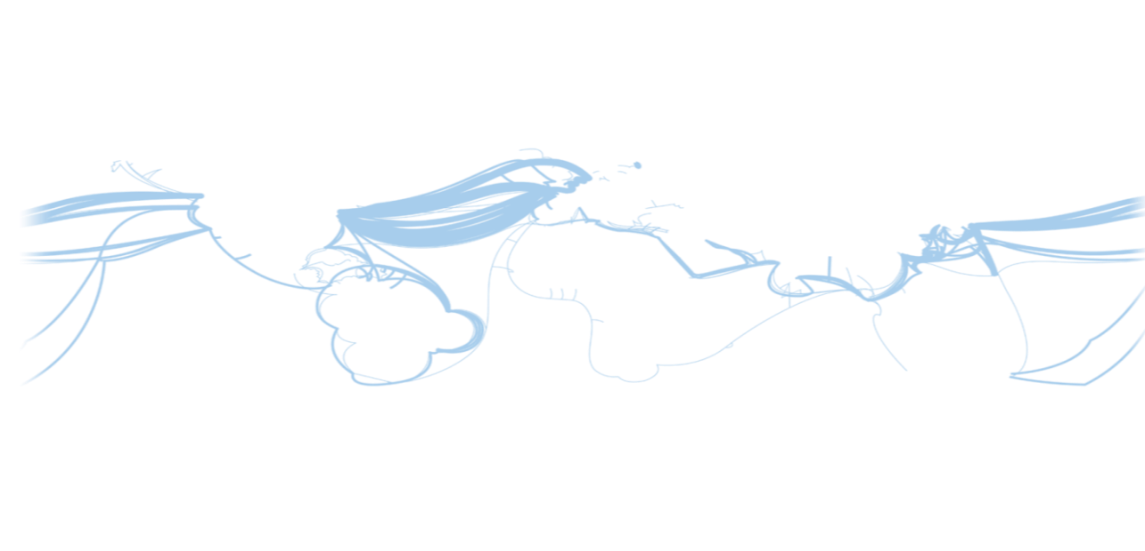
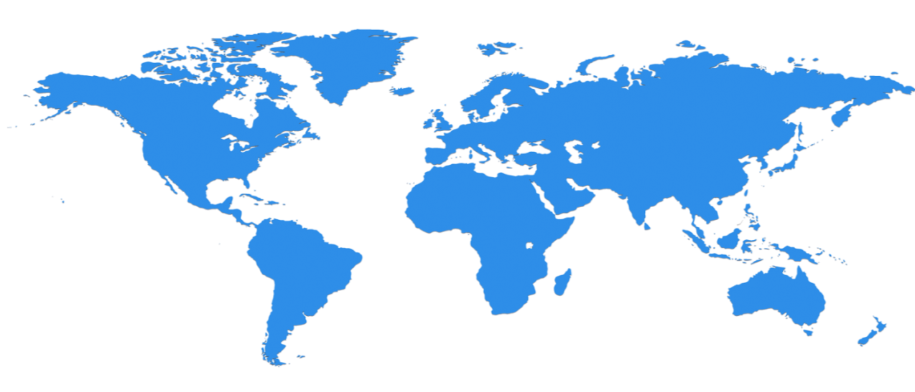

Hyper scale Infrastructure is the enabler
38 Regions Worldwide, 4 Upcoming Regions…huge capacity around the world…growing every year
North Central US
Illinois
United Kingdom
Regions
West Europe
Netherlands
Central US
Iowa
Canada Central
Toronto
Canada East
Quebec City
Germany North East
Magdeburg
China North *
Beijing
US Gov
Iowa
North Europe
Ireland
Germany Central
Frankfurt
China South *
Shanghai
Japan East
Tokyo, Saitama
West US
California
East US
Virginia
India Central
Pune
Japan West
Osaka
South Central US
Texas
East US 2
Virginia
US Gov
Virginia
India South
Chennai
India West
Mumbai
East Asia
Hong Kong
SE Asia
Singapore
Australia East
New South Wales
100+ datacenters
Top 3 networks in the world
2.5x AWS, 7x Google DC Regions
G Series – Largest VM in World, 32 cores, 448GB Ram, SSD…
Brazil South
Sao Paulo State
Australia South East
Victoria
Operational
Announced/Not Operational
* Operated by 21Vianet
Notes:
This slide was taken from Azure EBC Deck FY16 v1.3.pptx
Speaker Notes
Microsoft Azure itself is deployed around the world
Microsoft Azure involves the concept of regions, which is where you select to place and run your code
Each region has a Microsoft Azure data center
These data centers are massive facilities that host tens of thousands or, in some cases, hundreds of thousands of servers
As shown on this slide, we also have a number of Content Delivery Network (CDN) edge points. They can be used to cache your content and deliver it even faster to customers
What you are
Once you build an application, you can choose any location in the world where you want to run it and you can move your workloads from region to region.
You can also:
Run your application in multiple regions simultaneously
Just direct traffic and customers to whichever version of the app is closest to them
That gives you a
Notes
Microsoft Azure services, such as compute and storage are now available in eight worldwide data centers with an additional 24 CDN endpoints
You cannot have a real cloud without a data center global footprint and a chance to reach a bigger customer base or audience in new markets
going to see in the next couple months and years is that we will rapidly expand our data center footprint around the world. As a result, you will have more options for running your applications

Slide 18
Overview of Azure services
Compute
Networking
Data & Storage
Web & Mobile
Virtual Network
Service Fabric
Azure DNS
Container Service
Storage
Application Gateway
Web Apps
DocumentDB
Azure Virtual Machines
Traffic Manager
Mobile Apps
Azure SQL Database
ExpressRoute
Azure Cloud Services
Notification Hub
Load Balancer
StorSimple
Other services
Service Bus
Automation
Azure AD
Scheduler
Azure AD DS
Azure Backup
Key Vault
MFA
Site Recovery
Azure Security Center
Notes:
Provide a high-level overview of the Azure services, breaking them down by category. However, avoid discussing them in detail because it may take a long time.
10979C
1: Getting started with Microsoft Azure

Slide 19
Azure billing and support options
The most common Azure billing options include:
Pay-As-You-Go
Buy from a Microsoft Reseller
Enterprise agreements
Notes:
10979C
1: Getting started with Microsoft Azure

Slide 20
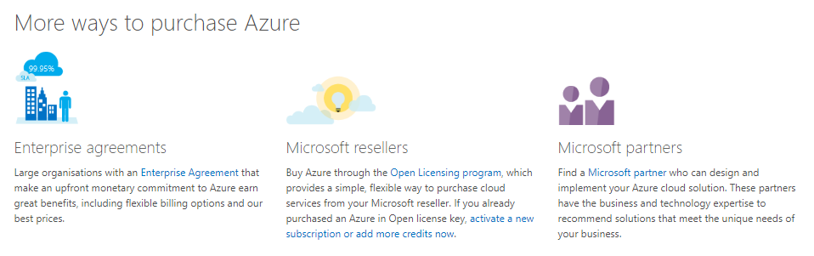

Slide 21
Account ‘s in Azure
We required any one of the account to get Microsoft azure account
Microsoft account
Organization account
Once Azure account is create it will be automatically mapped to one Azure subscriptions.
Azure subscription is holding all the services in the cloud. And we need to activate it.
We can manage multiple subscription in the single azure account.
Each and every subscription will have unique ID.
Subscription is a utility based . i.e., use and pay for it… what you have consumed.
Subscription limitations..

Slide 22
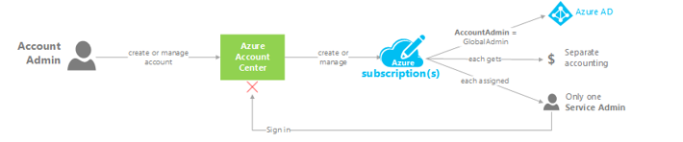
Account ‘s in Azure( contd…)
Administrative role | Limit | Summary
Account Administrator | 1 per Azure account | Authorized to access the Account Center (create subscriptions, cancel subscriptions, change billing for a subscription, change Service Administrator, and more)
Service Administrator | 1 per Azure subscription | Authorized to access Azure Management Portal for all subscriptions in the account. By default, same as the Account Administrator when a subscription is created.
Co-administrator | 200 per subscription (in addition to Service Administrator) | Same as Service Administrator, but can’t change the association of subscriptions to Azure directories.

Slide 23
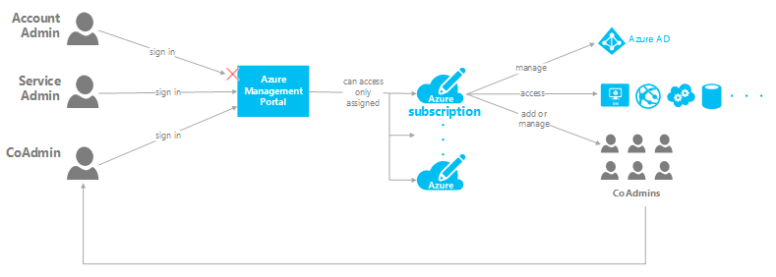
Account ‘s in Azure( contd…)
.

Slide 24
Account ‘s in Azure( contd…)
Account Administrator
Who creates the Azure account will be the Account administrator
Account Administrator can create subscription and cancel subscription, But Account administrator will not have access to create or deploy Virtual machines..etc.
Service Administrator:
Every subscription have a service administrator and we can have only one service administrator.
By default Account admin will the service administrator when the subscription is created.

Slide 25
Account ‘s in Azure( contd…)
Co-Administrator:
You can add users as co-administrators for a subscription using their Microsoft account or organizational account.
you should be designated as a global administrator in the directory for the subscription to grant access.
Differences between the service administrator and co-administrators:
Co-administrators can’t delete the Service Administrator from the Azure Management Portal. Only the Account Administrator can change this assignment at the Account Center.
The Service Administrator is the only user authorized to change a subscription’s association with a directory in the Azure Management Portal.

Slide 26
Subscription Limitations
If you want to raise the limit above the Default Limit, you can open an online customer support request at no charge.
The limits cannot be raised above the Maximum Limit value in the tables below. If there is no Maximum Limit column, then the specified resource does not have adjustable limits.
https://azure.microsoft.com/en-in/documentation/articles/azure-subscription-service-limits/

Slide 27
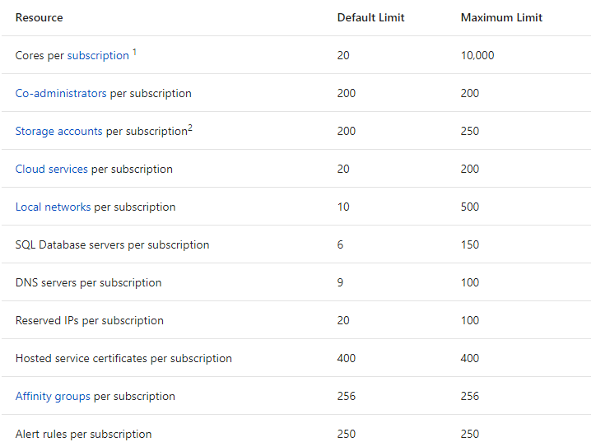
Subscription Limitations
Notes:
May change.. Please refer Microsoft site

Slide 28
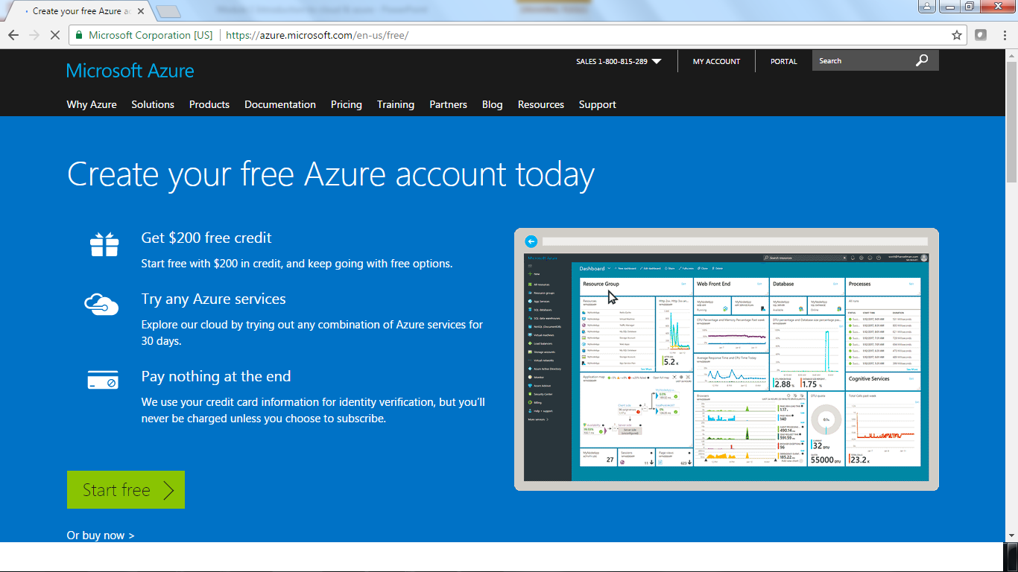
How to create a free trail account in Azure

Slide 29
Module 2: Azure Virtual Machine

Slide 30
Lesson1: Azure Deployment Models
Module Overview
Azure deployment models
ARM architecture and functionalities
Difference Between ASM and ARM
Resources Group
Azure portal
Azure management tools

Slide 31
Azure deployments models
Azure Service Manager (ASM)
Traditional way to deploy and manage applications hosted in Azure
Azure Management Portal
PowerShell / CLI (default mode)
REST API
Azure Resource Manager (ARM)
Modern way to deploy and manage applications hosted in Azure
Azure Resource Management Portal-Preview
PowerShell / CLI (ARM mode)
REST API
Azure Resource Management Library for .NET-
Notes:
REST API: Representational State Transfer Application Program Interface
Azure Resource Management Library for .NET: developers can use these libraries in production with full support by Microsoft through GitHub or Azure support channels
Refer https://azure.microsoft.com/en-us/blog/azure-management-libraries-for-net-generally-available-now/

Slide 32
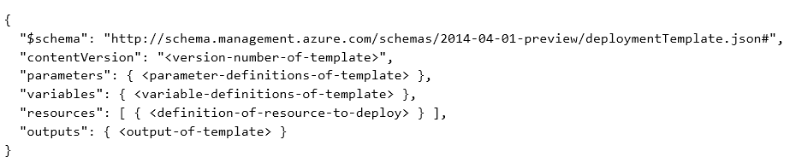
JSON templates
A growing expectation of any cloud offering is the ability to automate the deployment and management of infrastructure components and enable customers to build and manage higher level applications on top of these in a rich DevOps friendly way.
ARM and JSON templates
ARM allows customers to automate the deployment of their applications using a JSON template. A JSON template is a declarative, text-based file that defines the goal state of a deployment.
JSON templates allow users to define the resources that are needed for an application and specify deployment parameters to input values for different environments.
100% of create operations that are performed from Ibiza are done using templates.
ARM is responsible for validating the templates while the Resource Provider models provide a service that reads and orchestrates the creation of the resources they describe.
The example above shows the basic structure of a JSON template.
Notes:
Title: JSON templates

Slide 33
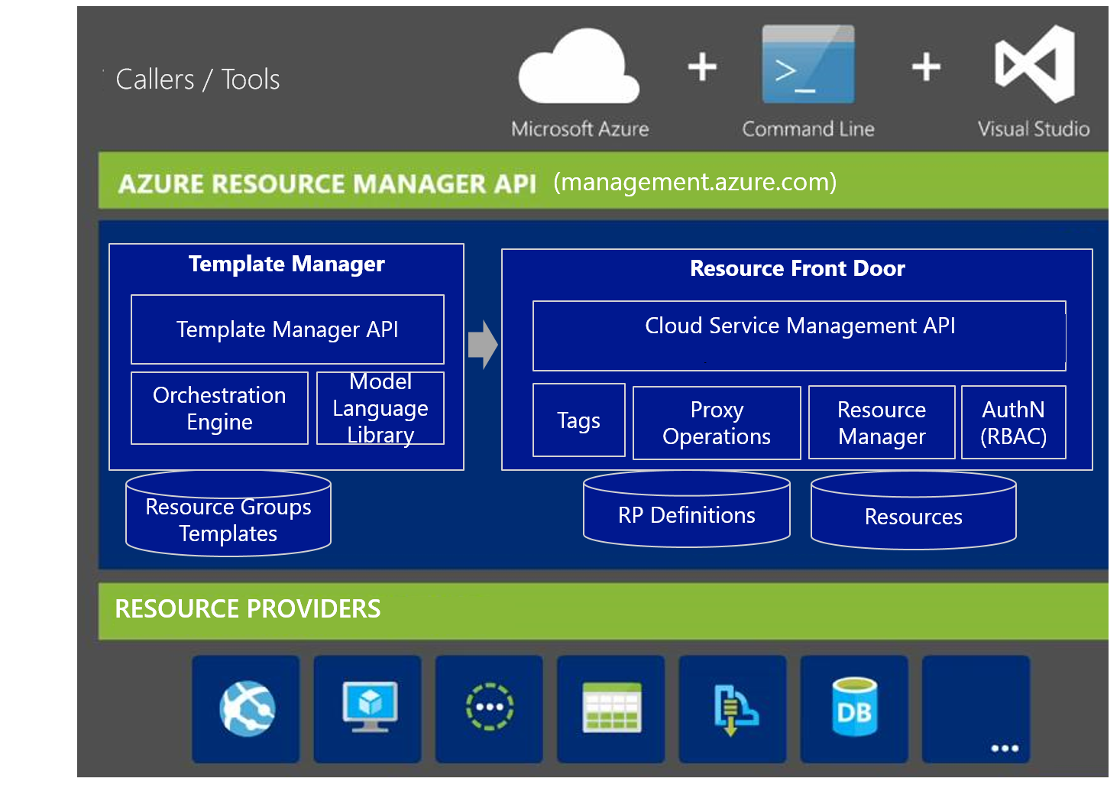
Azure Resource Manager’s architecture and functionalities
ARM serves as a consistent management layer for deploying, organizing, and securing applications. ARM operations include, but are not limited to, the following functionalities:
Accepts calls from the Portal (portal.azure.com), Visual Studio, and command line (PowerShell, Xplat CLI).
Enforces the throttling and resource quota based on subscriptionId.
Routes requests to proper Resource Provider (based on region + resource provider namespace).
Validates resource groups and resource membership.
Manages the resource and resource group
Creates tags and assigns tags to resources.
Verifies permissions.
Logs user actions for auditing.
Validates templates.
Notes:
Title: ARM’s architecture and functionalities
For each subscription and tenant, Resource Manager limits read requests to 15,000 per hour and write requests to 1,200 per hour. These limits apply to each Azure Resource Manager instance; there are multiple instances in every Azure region, and Azure Resource Manager is deployed to all Azure regions. So, in practice, limits are effectively much higher than those listed above, as user requests are generally serviced by many different instances.
How to throttling : Auto-scaling, Kill multiple request from same user for same request. Deploy multiple instance in deferent region
tags to your Azure resources to logically organize them by categories

Slide 34
Resource Provider v2
Moves common functionality (authN, authZ, auditing, regional routing) to common layer
Fully JSON based;
Deploy, manage, and monitor all of the resources for your solution as a group, rather than handling these resources individually.
Repeatedly deploy your solution throughout the development lifecycle and have confidence your resources are deployed in a consistent state.
uses declarative templates to define your deployment.
Define the dependencies between resources so they are deployed in the correct order.
Apply access control to all services in your resource group because Role-Based Access Control (RBAC) is natively integrated into the management platform.
Apply tags to resources to logically organize all of the resources in your subscription.
Clarify billing for the organization by viewing the rolled-up costs for the entire group or for a group of resources sharing the same tag.
Resource Manager provides a new way to deploy and manage your solutions.
Notes:
Title: Resource Provider v2

Slide 35
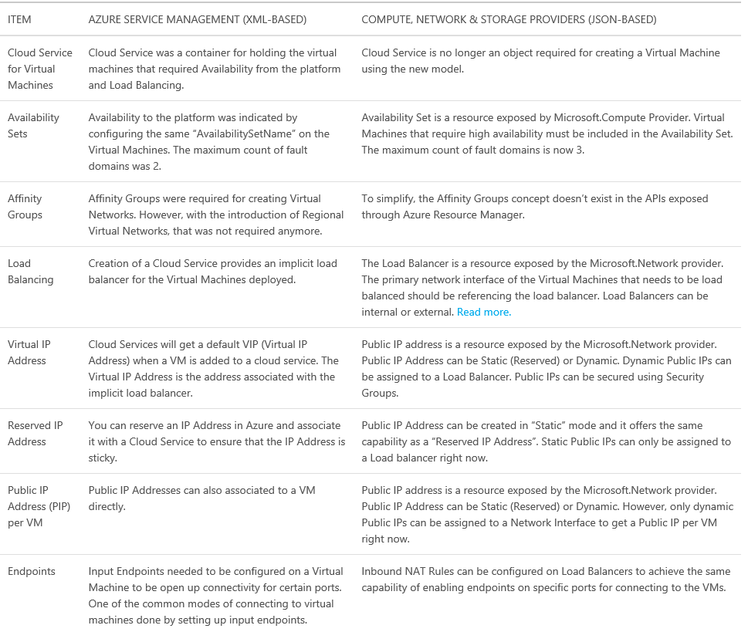
Differences between ASM and ARM
Notes:
Title: Differences between ASM and ARM
Export VM configuration in Classic
Export-AzureVM -ServiceName <ServiceName> -Name <ServerName> -Path C:\Users\“Prakash PC"\Desktop\xyz.xml

Slide 36
The benefits of using Resource Manager · You can deploy, manage, and monitor all the resources for your solution as a group, rather than handling these resources individually. · You can repeatedly deploy your solution throughout the development lifecycle and have confidence your resources are deployed in a consistent state. · You can manage your infrastructure through declarative templates rather than scripts. · You can define the dependencies between resources so they are deployed in the correct order. · You can apply access control to all services in your resource group because Role-Based Access Control (RBAC) is natively integrated into the management platform. · You can apply tags to resources to logically organize all the resources in your subscription. · You can clarify your organization's billing by viewing costs for a group of resources sharing the same tag.

Slide 37
Resource - A manageable item that is available through Azure. Some common resources are a virtual machine, storage account, web app, database, and virtual network, but there are many more. Resource Group - A container that holds related resources for an Azure solution. The resource group can include all the resources for the solution, or only those resources that you want to manage as a group. You decide how you want to allocate resources to resource groups based on what makes the most sense for your organization. Resource provider - A service that supplies the resources you can deploy and manage through Resource Manager. Each resource provider offers operations for working with the resources that are deployed. Some common resource providers are Microsoft Compute, which supplies the virtual machine resource, Microsoft Storage, which supplies the storage account resource, and Microsoft Web, which supplies resources related to web apps. {resource-provider}/{resource-type} Resource Manager template - A JavaScript Object Notation (JSON) file that defines one or more resources to deploy to a resource group. It also defines the dependencies between the deployed resources. The template can be used to deploy the resources consistently and repeatedly. Declarative syntax - Syntax that lets you state "Here is what I intend to create" without having to write the sequence of programming commands to create it. The Resource Manager template is an example of declarative syntax. In the file, you define the properties for the infrastructure to deploy to Azure.
Notes:
Microsoft.KeyVault/vaults: This resource provider offers a resource type called vaults for creating the key vault.

Slide 38
Resource Groups
Loosely coupled containers of multiple resources of similar or different types
Every resource must exist in one and only one resource group
Resource groups can span regions
RESOU
R
CE G
R
OUP
Notes:
Title: Resource Groups

Slide 39
Coupling for resources
Resource Group is a unit of management
Lifecycle: deployment, update, delete, status
Identity: resources can talk to each other
→ Grouping: Metering, billing, quota: applied & rolled up to group
Notes:
Title: Coupling for resources
Meteting:Represents a usage event for plans
EventId The event identifier of the record.
State The State of the event. Possible values are:
Value Description
0 Acknowledged
1 Rejected
2 Pending Approval
3 Approved
Method: The HTTP method that was performed on the entity. Possible methods are Post, Put, Patch, and Delete. In a Patch call, only the updated properties are populated in the entity.
Entity: The object instance. The object instance type is determined by the REST call that retrieved the entity.
EntityParentId: The parent entity identifier.
NotificationEventTimeCreated: The time of the notification event.

Slide 40
Resource Group: management container
Lifecycle: deployment, update, delete, status
Grouping: metering, billing, quota, user experience (portal, PowerShell, CLI)
Access Control: scope for RBAC permissions
Identity: resources can talk to each other
Notes:
Title: Resource Group: management container

Slide 41
Resource Group lifecycle
Question:
Should these resources be in the same group or a different one?
Hint:
Do they have common lifecycle and management?
Answer:
Up to you.
Notes:
Title: Resource Group lifecycle

Slide 42
Resource characteristics
Resource group
Resource exists in precisely one resource group at any time
Resource can be moved from one resource group to another
Location
Resource can be created in any region where there is an a appropriate resource provider
Locks
Resource can be locked to prevent deletion
Tags
Resource can be tagged to provide (billing) metadata
Notes:
Title: Resource characteristics

Slide 43
Resource Group characteristics
Two types of resource groups
Lifecycle
Shared
Lifecycle
Contains resources with common lifecycle and management
e.g., virtual machines and storage accounts for an application
Shared
Contains resources shared among several resource groups
e.g., VNETs used to host VMs from many applications
Notes:
Title: Resource Group characteristics

Slide 44
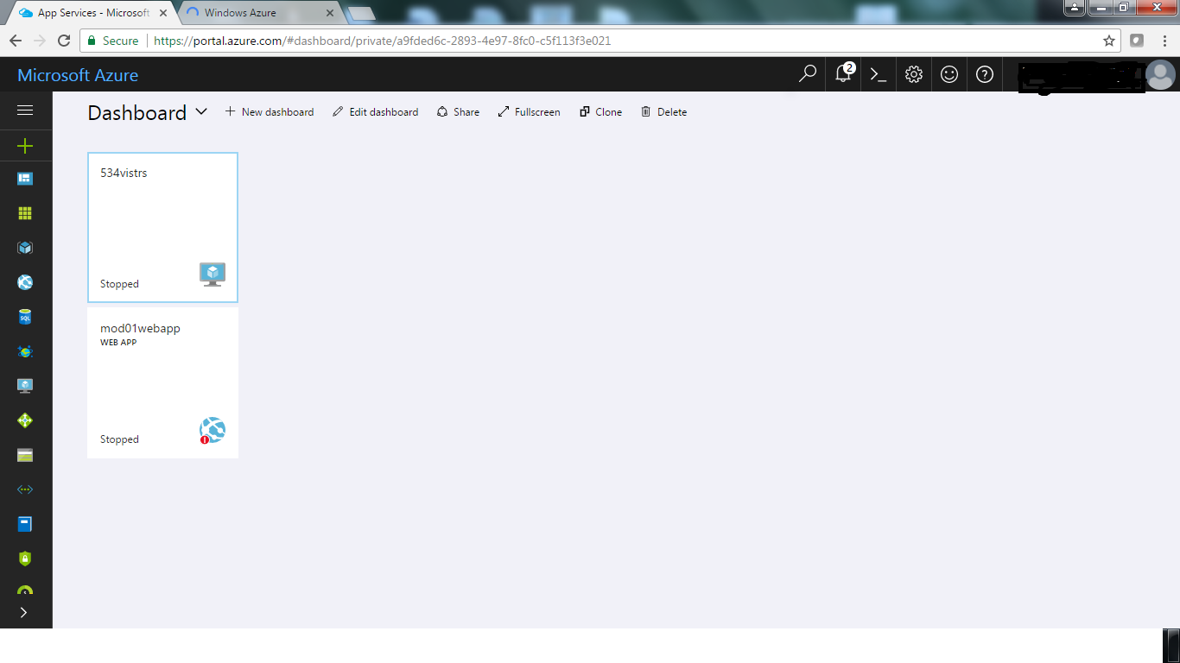
Azure resources manager portal

Slide 45
Resource Groups Best Practices
Tightly coupled containers of multiple resources of similar or different types
When resources are in the container, they have a common life cycle. You can deploy these things together, put RBAC on them together with one request and they can know about each other
Every resource *must* exist in one and only one resource group
Every resource must be in ONE resource group, important for RBAC
Resource groups can span regions
Don’t have to live in same location, can deploy to multiple regions

Slide 46
Azure PowerShell
The Azure PowerShell modules are:
Grouped into:
Azure Resource Manager
Azure Service Management
Azure Storage
Installed by using:
Web PI
The PowerShell Gallery
The GitHub repository
The Azure AD PowerShell module:
Provides cmdlets for managing Azure AD
Uses a stand-alone installer
Notes:
10979C
2: Microsoft Azure management tools

Slide 47
Managing Azure subscriptions by using Azure PowerShell
Azure Resource Management:
Authenticate
Add-AzureRmAccount
Select the target Azure subscription (if more than one exists):
Get-AzureRmSubscription
Select-AzureRmSubscription
Service Management (classic deployment):
Authenticate
Add-AzureAccount
Select the target Azure subscription (if more than one exists):
Get-AzureSubscription
Select-AzureSubscription
Notes:
10979C
2: Microsoft Azure management tools

Slide 48
Azure CLI
Command-line shell:
Can be installed on Windows, Linux, and OS X
Integrates with Linux shell scripting tools
Has an installation process that depends on the operating system:
Web PI for Windows
An npm package for Linux and OS X
To authenticate:
Azure login
http://aka.ms/devicelogin
Microsoft account or Azure AD user credentials
To switch modes, run:
azure config mode arm
azure config mode asm
Notes:
10979C
2: Microsoft Azure management tools

Slide 49
Lesson 2 Azure VM
Module Overview
Understanding VM
VM availability
Understanding disks

Slide 50
What are Azure VMs?
Use Azure VMs to:
Extend your datacenter to increase agility
Migrate your workloads from on-premises datacenters or from other cloud providers
Implement test or development
Key differences when using Azure VMs:
Read-only VM console access
You can create Azure VMs by using:
The Azure Portal
Azure PowerShell or Azure CLI
Azure Resource Manager templates
Notes:
Explain the main benefits of deploying VMs in Azure. Discuss some common scenarios. In addition, explain the differences between on-premises Microsoft Hyper-V VMs and VMs in Azure. Lastly, mention the method of calculating Azure VM charges.
There are additional slides for this topic.
10979C
3: Virtual machines in Microsoft Azure

Slide 51
Azure VM sizes
A-series:
Basic: No load balancing or auto-scaling support
Standard:
A0-A7, general computing
A8-A11, compute intensive
D-series:
Faster CPUs and local Hyper-V host SSD (temporary disk)
Dv2 series:
35% faster CPU than D-series
G-series:
Largest VMs (up to 448 GB of RAM and 64 data disks)
DS, DSv2, and GS series:
Support for Premium Storage (SSD for operating system and data disks)
Notes:
10979C
3: Virtual machines in Microsoft Azure

Slide 52
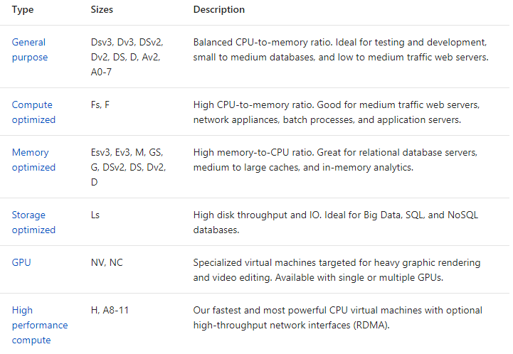

Slide 53
Create a VM by using the Azure Portal
The Azure Portal based experience:
VM name
Admin credentials
Target resource group, Azure datacenter, subscription
VM size
Target storage location (Azure Storage account)
Target virtual network and subnet (private IP)
Optional public (Internet-accessible) IP and DNS name
Network security group
Extensions
Monitoring (preferably by using another Azure Storage account)
Notes:
10979C
3: Virtual machines in Microsoft Azure

Slide 54




Provisioning to the Cloud
Getting Started
Select Image and VM Size
New Disk Persisted in Storage
Windows Server
Boot VM from New Disk
Management Portal(s)
Linux
>_
A0 – A11
Scripting
(Windows, Linux and Mac)
Blob Storage
D1 – D4/D11 – D14
D1_v2 – D15_v2
DS1 – DS4/DS11 – DS14
Azure Resource Manager (ARM)
DS1_v2 – DS15_v2
Cloud
G1 – G5
GS1 – GS5
REST API
Notes:
Slide Objective
Explain the workflow for provisioning VMs in the cloud.
Notes
Cloud First Provisioning means exactly what it says—building a VM in the cloud first.
There are three methods of starting this process. Build a VM from:
The portal
Command line
Programmatically calling the Representational State Transfer Application Programming Interface (REST API)
Once you choose your provisioning method, select the image and instance size to start.
ARM - http://blogs.msdn.com/b/scicoria/archive/2015/02/12/azure-resource-manager-creating-an-iaas-vm-within-a-vnet.aspx
The new disk will be stored in blob storage and your machine will boot.

Slide 55
Supported Windows Server Applications
Microsoft BizTalk Server - Microsoft BizTalk Server 2013 and later versions
Microsoft Dynamics AX - Microsoft Dynamics AX 2012 R3 and future updates
Microsoft Dynamics GP - Microsoft Dynamics GP 2013 and later versions
Microsoft Dynamics NAV - Microsoft Dynamics NAV 2013 and later versions
Microsoft Forefront Identity Manager - Microsoft Forefront Identity Manager 2010 R2 SP1 and later versions
Microsoft HPC Pack - Microsoft HPC Pack 2012 and later versions
Microsoft Project Server - Microsoft Project Server 2013 and later versions
Microsoft SharePoint Server - Microsoft SharePoint Server 2010 and later versions are supported on Windows Azure Virtual Machines.
Microsoft SQL Server - 64-bit versions of Microsoft SQL Server 2008 and later versions
Microsoft System Center - Microsoft System Center 2012 SP1 and later versions are supported for the following applications:
•App Controller
•Configuration Manager
•Endpoint Protection
•Operations Manager
•Orchestrator
•Server Application Virtualization
•Service Manager
Microsoft Team Foundation Server 2012 and later versions
Microsoft Exchange
For the most up to date list : http://support.microsoft.com/kb/2721672
http://support.microsoft.com/kb/2721672
Notes:
http://support.microsoft.com/kb/2721672
Windows Server
Windows Server 2008 R2 and later versions are supported for the following roles:
AD Domain Services
AD Federation Services
AD Lightweight Directory Services
Application Server
DNS Server
Fax Server
Network Policy and Access Services
Print and Document Services
Web Server (that is to say., Internet Information Services - IIS)
Windows Deployment Services
Windows Server Update Services
File Services
[EDITOR] Biju
08 October 2013 Kindly list the versions as MS Style prohibits “or later” expressions.

Slide 56




Linux on Microsoft Azure
Supported Versions:
SUSE SLES 11 Service Pack 3+ (SP3), SLES 12+
openSUSE 13.1+
CentOS 6.3+,7.0+ by OpenLogic*
Ubuntu Server 12.04.1+,14.04, 15.10 and 16.04
Oracle Linux 6.4+, 7.0+
Red Hat Enterprise Linux RHEL 6.7+, 7.1+
CoreOS 494.4.0+
Specific versions are endorsed:
Integration Components
Testing and validation by partners
Bring other variants at your own risk**
*Image provided by OpenLogic based on CentOS 6.5 – 7.1
**Interoperation work will be Required
*** Only Linux VMs in the gallery are supported
Notes:
https://azure.microsoft.com/en-us/documentation/articles/virtual-machines-linux-endorsed-distros/
The list above is not meant to be an exhaustive list. See the link to get a complete list
Change in
M 02-IaaS - VirtualMachines.pptx, Slide 11
Slide Objectives
Provide an understanding of which distributions of Linux are offered in the Microsoft Azure
Speaker Notes
On this page you will find the details about the support we provide for Linux images:
http://support.microsoft.com/kb/2941892/en-us
http://azure.microsoft.com/en-us/documentation/articles/virtual-machines-linux-endorsed-distributions/
VM images of these distributions are provided by partners who are experts in each distribution
Other distributions of Linux can be installed as Bring-Your-Own-Linux. However, some interoperation work will be needed
VMDepot (The virtual machine images on this site are provided and licensed to you by community members. Microsoft Open Technologies does not screen these images for security, compatibility or performance, and does not provide any license rights or support for them.): http://vmdepot.msopentech.com/List/Index

Slide 57
Windows Server Roles that are Not Supported
Server Role
Hyper-V
Windows Deployment Services
Remote Access (Direct Access, Routing)
Rights Management Services
Dynamic Host Configuration Protocol Server
http://support.microsoft.com/kb/2721672
Notes:
http://support.microsoft.com/kb/2721672
Every on-premises network/machine configuration is not supported in Microsoft Azure.
Hyper-V: It makes no sense to have Hyper-V capability on a machine that is hyper-vised in Microsoft Azure, so this is not supported
Dynamic Host Configuration Protocol (DHCP)/Network Load Balancing (NLB): Both of these use broadcasting to work, which is very difficult to implement in any cloud (including competitors)
Failover Clustering: Requires a floating IP, but Microsoft Azure assigns a specific IP
BitLocker encryption: Requires Trusted Platform Module (TPM) chip compatibility and the Microsoft Azure commodity machines do not have this. You can currently enable bitlocker on a data disk though
Client Operating System (OS): We support on server operating systems at this point. In addition, the client OS license does not transfer to the cloud
[EDITOR] Biju:
08 October 2013 “Hypervisor” is being used in verb form here. Kindly replace with the appropriate word. For example, “hypervisor enabled”
[EDITOR] TWB_Trevor:
08 October 2013 This claim needs to be validated or the expression “including competitors” can be removed.
[EDITOR] Biju
08 October 2013 Should this be “ We support Microsoft Azure on server….”
[EDITOR] TWB_Trevor:
08 October 2013 Has “Virtual Desktop Services” intentionally not been explained?

Slide 58
Windows Server Features that are not Supported
Server Feature
BitLocker Drive Encryption (C: Drive only)
Internet Storage Name Server
Multipath I/O
Network Load Balancing
Peer Name Resolution Protocol
SNMP Services
Storage Manager for SANs
Windows Internet Name Service
Wireless LAN Service
Notes:
http://support.microsoft.com/kb/2721672
Bitlocker: Locking the driver
Internet Storage Name Service (iSNS) protocol allows automated discovery, management and configuration of iSCSI and Fibre Channel devices on a TCP/IP network.
iSCSI and Fibre Channel: High-speed network technology
Network Load Balancer: Balance load at network layer
Peer Name Resolution Protocol (PNRP) is a peer-to-peer protocol designed by Microsoft. PNRP enables dynamic name publication and resolution
SNMP Services: Simple Network Management Protocol (SNMP) is a protocol for network management
Windows Internet Name Service (WINS) is Microsoft's implementation of NetBIOS
[EDITOR] Biju:
08 October 2013 “Hypervisor” is being used in verb form here. Kindly replace with the appropriate word. For example, “hypervisor enabled”
[EDITOR] TWB_Trevor:
08 October 2013 This claim needs to be validated or the expression “including competitors” can be removed.
[EDITOR] Biju
08 October 2013 Should this be “ We support Microsoft Azure on server….”
[EDITOR] TWB_Trevor:
08 October 2013 Has “Virtual Desktop Services” intentionally not been explained?

Slide 59
Azure VM Agent and Extensions
VM Agent is used to install, configure, manage and run Azure VM Extensions
Installs, configures, and removes VM extensions on instances of Azure VMs
Enable via Portal or PowerShell
Available for Windows and Linux
VM Extensions provide dynamic features that Microsoft and other third parties provide
Modify security and identity features, such as resetting account values and using antimalware
Start, stop, or configure monitoring and diagnostics
Reset or install connectivity features, such as RDP and SSH
Diagnose, monitor, and manage your VMs
Notes:
$vm = Get-AzureVM –serviceName
$svc –Name $name $vm.VM.ProvisionGuestAgent = $TRUE
Update-AzureVM –Name $name –VM $vm.VM –ServiceName $svc
Azure VM Extensions and Features
https://azure.microsoft.com/en-in/documentation/articles/virtual-machines-windows-extensions-features/

Slide 60
VM availability

Slide 61
"Announced Single Instance Maintenance" means periods of Downtime related to network, hardware, or Service maintenance or upgrades impacting Single Instances. We will publish notice or notify you at least five (5) days prior to the commencement of such Downtime.
"Availability Set" refers to two or more Virtual Machines deployed across different Fault Domains to avoid a single point of failure.
"Data Disk" is a persistent virtual hard disk, attached to a Virtual Machine, used to store application data.
"Fault Domain" is a collection of servers that share common resources such as power and network connectivity.
"Operating System Disk" is a persistent virtual hard disk, attached to a Virtual Machine, used to store the Virtual Machine’s operating system.
"Single Instance" is defined as any single Microsoft Azure Virtual Machine that either is not deployed in an Availability Set or has only one instance deployed in an Availability Set.
"Virtual Machine" refers to persistent instance types that can be deployed individually or as part of an Availability Set.

Slide 62
Service Level Agreements (SLA)
For Cloud Services, we guarantee that when you deploy two or more role instances in different fault and upgrade domains, your Internet facing roles will have external connectivity at least 99.95% of the time.
For all Internet facing Virtual Machines that have two or more instances deployed in the same Availability Set, we guarantee you will have external connectivity at least 99.95% of the time.
For Virtual Network, we guarantee a 99.9% Virtual Network Gateway availability.
"NO SLA" under the single instance
Notes:
https://azure.microsoft.com/en-in/support/legal/sla/virtual-machines/v1_6/
Slide Objectives
You need an Availability Set (AS) for a 99.95% Service Level Agreement (SLA).
Speaker Notes
Microsoft will provide at least 90 days' notice for adverse material changes to any of the SLAs listed above (content from: http://azure.microsoft.com/en-us/support/legal/sla/).
A cloud service must have at least two instances of every role to qualify for the Azure Service Level Agreement, which guarantees external connectivity to your Internet-facing roles at least 99.95 percent of the time. With at least two VMs performing the same workload grouped into an Availability Set, you get a 99.95% SLA.
More information:
It's better to report the SLA per month as the billing cycle is monthly based which is 20 minutes / month per VM
http://azure.microsoft.com/en-us/support/legal/sla/
No SLA for single VM see:
https://tr19.techreadytv.com/sessions/AZR326.aspx

Slide 63
VM Availability
To ensure high availability of an application, Azure places VMs into a logical grouping called a Availability Set.
When deployed with a service, Azure ensures that the VMs in the Availability set are arranged across Fault Domains on different Racks. In case of a maintenance event or failure of one fault domain, at least one VM keeps running.
Along with Load balancers, availability sets can provide up to 99.9% SLA for VMs.

Slide 64
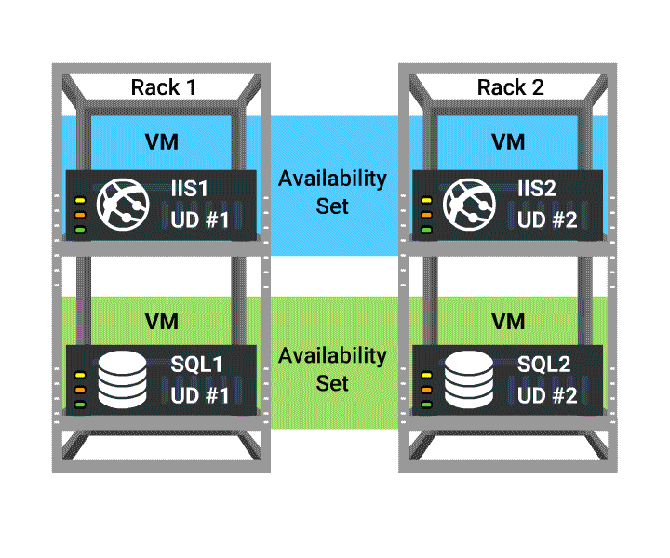

VM Availability - Fault Domain: A fault domain is a set of hardware components (rack of resources like servers, power, etc.) that share a single point of failure. Web, worker and Virtual Machines are arranged in this hardware. Azure deploys an application or service across multiple fault domains

Slide 65
VM Availability - Fault Domain
When you put VMs in to an availability set, Azure guarantees to spread them across Fault Domains and Update Domains. A Fault Domain (FD) is essentially a rack of servers. It consumes subsystems like network, power, cooling etc. So 2 VMs in the same availability set means Azure will provision them in to 2 different racks so that if say, the network or the power failed, only one rack would be affected.
there are always only 3 fault domains: FD0 ,FD1 and FD2. It makes it seem like your VMs only get spread across 3 racks but that’s not the case. They can be spread across more racks if you’ve got lots of VMs. But as far as your availability set is concerned FD0 and FD1 are a way of saying “This bit of infrastructure (FD0) is different to this bit (FD1). As you boot VMs in to an availability set, they get allocated like this – FD0, FD1, FD2, FD0, FD1, FD2 and so on. The pattern never changes. You’ve probably seen this diagram hundreds of times

Slide 66
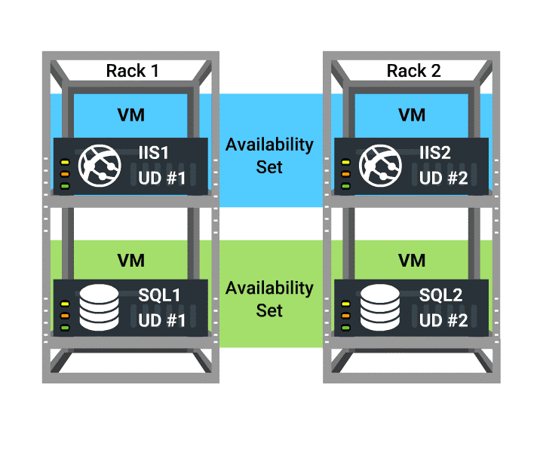
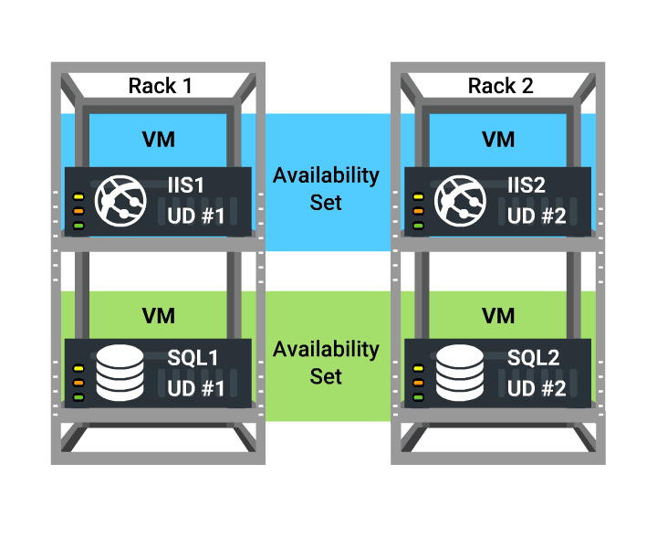
VM Availability - Update Domain : Update domain in Azure means, that all physical servers in one update domain will get host updates like firmware, drivers and OS updates at the same time.
In the Illustration UD#1 is getting updated but the user can access the content from UD#2.
It provides Web or Worker role (within rack) instances with high availability by ensuring that only one of the Instances is down for an update at one time.

Slide 67
Update Domains
Sometimes you need to update your app, or Microsoft needs to update the host on which your VM(s) are running. Note that with IaaS VMs, Microsoft does not automatically update your VMs. You have complete control (and responsibility) over that. But say if a serious security vulnerability is identified and a patch created. It’s in Microosft’s interest to get that applied to the host underneath your VM as soon as possible. So how is that done without taking your service offline? Update Domains. It’s similar to the FD methods, only this time, instead of an accidental failure, there is a purposeful move to take down one (or more) of your servers. So to make sure your service doesn’t go offline because of an update, it will walk through your update domains one after the other.
VM | Fault Domain | Update Domain
VM0 | 0 | 0
VM1 | 1 | 1
SVM2 | 2 | 2
VM3 | 0 | 3
VM4 | 1 | 4
VM5 | 2 | 0

Slide 68
Fault and Update Domains
Fault domains:
Represent groups of resources anticipated to fail together, i.e. same rack, same server
Fabric spreads instances across fault at least two fault domains
The number of fault domains is controlled by the Azure Fabric
Anticipated to fail together: share power source and network switch
3 fault domains by default
Update domains:
Represents groups of resources that will be updated together
Host OS updates honour service update domains
Specified in service definition
Default of five (up to 5)
More than 5 update domains allowed
Fabric spreads role instances across update domains and fault domains
Notes:
Slide Objective
Discuss achieving very high availability with Microsoft Azure
Notes
To achieve high availability and fault tolerance, we have adopted fault and upgrade domains for deploying and upgrading applications. A fault domain is essentially a single point of failure. Thus, a rack of hardware in a data center can be a fault domain, since a power outage of the rack will take out the collection of hardware. Under this assumption, Microsoft Azure deploys role instances of an application into at least two fault domains by default, which ensures fault tolerance.
When possible, Microsoft Azure distributes role instances of an application evenly into multiple update domains, with each update domain as a logical unit of the application’s deployment. This means that host updates honor those update domains, ensuring the least possible impact to the running service. You can control many update domains using an attribute in the service definition.
Points to Remember
A fault domain is a physical unit of failure, and is closely related to the physical infrastructure in the data centers
In Microsoft Azure, the rack can be considered a fault domain. However, there is no 1:1 mapping between fault domain and rack
Microsoft Azure is responsible for deploying the instances of your application in different fault domains
This only applies if you run more than one instance
Now, Microsoft Azure ensures that your application uses at least two fault domains. However, depending on capacity and VM availability, your application may be spread across more than two fault domains
As a developer, you have no direct control over how many fault domains your application will use, but the way you configure it may impact your availability
You can have up to 5 Update domains. Cannot adjust past this.
[EDITOR] TWB_Trevor:
08 October 2013 Microsoft Azure Fabric was changed to just “Microsoft Azure” because MSStyle recommends that “fabric” be used sparingly in customer-facing content.
In other slides/notes pages of this PPT, Fabric has been changed to “Microsoft Azure” as applicable to the context. Where the context was not clear, a comment has been added.

Slide 69
VM Availability Sets
Update domains are honored by host OS updates
Fault Domain
Fault Domain
Rack
Rack
VM
VM
Availability Set
IIS1
IIS2
UD #1
UD #2
Availability Set
VM
VM
SQL1
SQL2
UD #1
UD #2
Notes:
Slide Objective
Explain Availability Sets
Notes
Availability Sets tell the Fabric Controller (FC) to place VMs in the same set on different racks for faults and in separate upgrade domains for updates.
This essentially tells the FC not to take down the guest OS of all VMs in the same set for host updates.
When you first come into the slide, you will see four separate VMs.
<Click> the VMs with IIS (1 and 2) are grouped into an AS. It is up to you to find out how these machines are grouped
<Click><Click>, as in the previous slide, it shows machines being separated into fault domains even though they may belong to a different AS
<Click><Click>, shows how the machines within an AS are separated within update domains
[EDITOR] TWB_Trevor:
08 October 2013 This was originally “take the guest OS down”. Kindly confirm that the edit has not affected technical accuracy.

Slide 70

How Does this Relate to the SLA?
Availability Set
VM
VM
VM
No SLA*
SLA 99.95
* No guaranteed SLA for single VM instance
Notes:
How does this relate to the SLA?
We have something new now called Availability Sets, which are similar to fault domains. You can specify VMs together, running in an AS and be able to realize a 99.95 SLA around that. When you are provisioning VMs; you will see that you can group them together in Availability Sets.
The figure on the slide does not represent SQL Clustering (currently not available in Microsoft Azure), it represents what may be a failover setup, mirroring etc.
[EDITOR] TWB_Trevor:
08 October 2013 Should “SQL Clustering” be changed to “SQL Server clustering”? Note that the image on the slide shows instances of SQL Server.
[EDITOR] Biju
08 October 2013
Does this feature qualify to be termed new as per LCA guidelines. Kindly refer http://lcaweb/marketing/contentguide/Pages/RedFlag.aspx

Slide 71

End-to-End Highly Available Solution
Redundancy at every level
SQL-AVSET
SQL
Server
IIS Web Application
IIS-AVSET
Internet
Web VM
SQL Mirroring
LB
IIS Web Application
Web VM
SQL
Server
Notes:
The slide represents high availability in terms of:
Having multiple web roles in an IIS application but having it load balanced by Microsoft Azure
AS for the SQL Servers. Notice that this is not load balanced because we can only point to one (no SQL Clustering)
[EDITOR] TWB_Trevor:
08 October 2013 Should “SQL Clustering” be changed to “SQL Server clustering”? Note that the image on the slide shows instances of SQL Server.

Slide 72
Deploying Azure VM using Scale Sets & Templates
Virtual machine scale sets are an Azure compute resource that you can use to deploy and manage a set of identical VMs. With all VMs configured the same, scale sets are designed to support true autoscale, and no pre-provisioning of VMs is required. So it's easier to build large-scale services that target big compute, big data, and containerized workloads.
Notes:
JSON Schema is a JSON media type for defining the structure of JSON data.JSON Schema is intended to define validation, documentation, hyperlink navigation, and interaction control of JSON data.
https://docs.microsoft.com/en-us/azure/virtual-machine-scale-sets/virtual-machine-scale-sets-overview

Slide 73
Understanding Disks

Slide 74
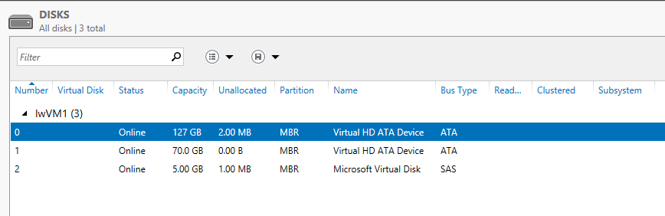
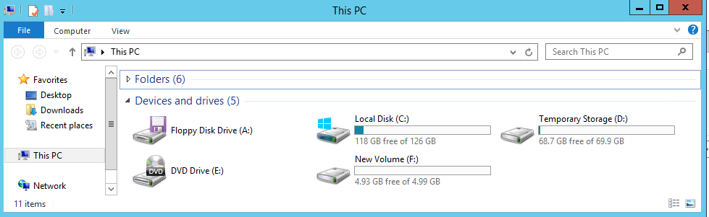
VM Disk Layout – Windows OS
OS Disk
Persistent
SATA
Drive C:
* Max. size of C:\ drive – 1,023GB
Notes:
Maximum size of C:\ drive is 1023 GB

Slide 75
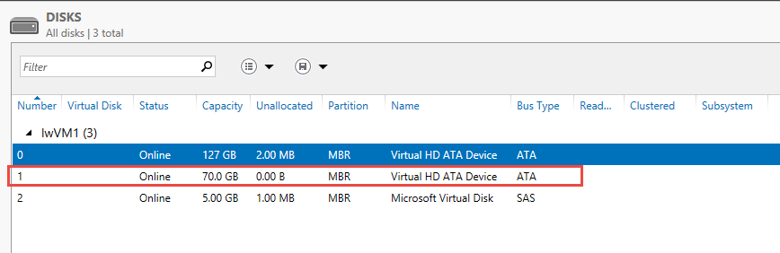
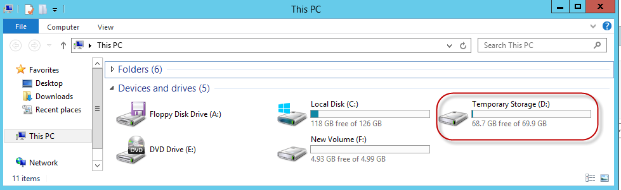
VM Disk Layout – Windows OS (continued)
Temporary Storage Disk
Local (Not Persistent)
SATA/SSD
Drive D:

Slide 76
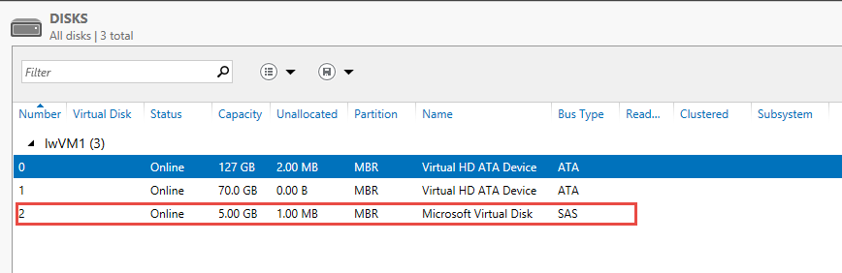
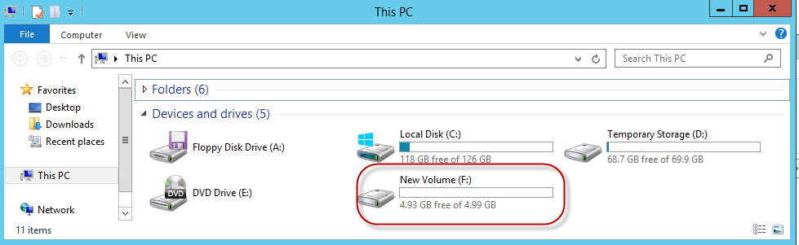
VM Disk Layout – Windows OS(continued)
Data Disk(s)
Persistent
SCSI
Customer-defined Letter

Slide 77
Persistent Disk Management – Windows OS
C:\ = OS Disk
D:\ = Non-Persistent Cache Disk
E:\, F:\. G:\ and all subsequent Data Disks—you will need to attach and format them
Capability | OS Disk | Data Disk
Host Cache Default | ReadWrite | None
Max Capacity | 1023 GB | 1 TB
Imaging Capable | Yes | No
Hot Update | Cache Setting requires a reboot | Change Cache without reboot, Add/Remove without reboot
Notes:
Persistent Disk Management
The OS Ddisk is by default 127 GB and can be up to 1TB and the data disk max size is 1TB
The D:\ drive is for non-persistent cache – the size of the D drive will change depending on what size machine you pick
The C:\ drive is the OS disk
E:\ and all subsequent drive letters represent data disks
[EDITOR] TWB_Trevor:
08 October 2013 Kindly validate the edit
[EDITOR] TWB_Trevor:
08 October 2013 Is this supposed to be “Ddisk” or just “disk”?

Slide 78
Disk Caching – Windows OS
Modify using the Set-AzureOSDisk or the Set-AzureDataDisk cmdlets
Supported Cache Modes:
Disk Type | Read Only | Read Write | None
OS Disk | Supported | Default | Not Supported
Data Disks | Supported | Supported | Default
Temporary Disk | Not stored in Microsoft Azure Storage Blob Service
Notes:
Slide Objectives
Explain Disk Caching
Speaker Notes
Data Disks can have caching enabled on up to four disks.
Virtual Machine Disk Cache Preferences
Disk cache can be configured as Read only, Read Write or None (disabled).
· Read Only: Reads and writes are cached for future reads. All writes are persisted directly to the Microsoft Azure Storage Blob service.
· Read Write: Reads and writes are cached for future reads. Regular writes are persisted to the local cache. If Write-through, Forced Unit Access (FUA) or flush is asserted, the write will commit directly to the Microsoft Azure Storage Blob service.
· None (disabled): Bypasses cache completely. All disk transfers are completed against the Microsoft Azure Storage blob service.
Cache performance behavior
When host caching is enabled, all disk requests that result in a cache hit will be completed from the local host cache. The performance for all cache hits is ultimately limited by the physical host local hard disk performance.
In scenarios where the physical host’s hard disks are not saturated (still have some idle capacity), enabling host caching is likely to help reduce disk I/O latency. After the point of saturation is reached, new requests will have to be queued inside the host and wait for processing, causing latency to grow with the size of the resulting disk queue.
Testing shows that enabling Read Write cache for the OS disk helps improve overall operating system performance and boot times. This is the default setting for the OS disk.
For data disks, the performance benefit of host caching will depend on the pattern and intensity of the disk workload that is being generated. The general guideline is to leave host caching set to the default of None (disabled), because this bypasses the physical host local disks, thus being capable of providing the largest I/O rate.
General best practices to configure the cache
· Read Only – Applications that may not assert Write-through, Forced Unit Access (FUA) or flush correctly. Requires all writes to be persisted to Microsoft Azure Storage to prevent data loss or data corruption while still enabling read cache.
· Read Write – Offers the lowest disk latency for light workloads. Recommended for the OS disk and for data disks with sporadic disk access. Total workload should not frequently exceed the performance of the physical host local hard drives.
· None (disabled) – Bypasses the local cache completely. This will prevent the physical host local hard drives from becoming a bottleneck. Offers the best performance for I/O intensive workloads.

Slide 79
Azure VMs disk mobility
Azure virtual disks:
.vhd format (.vhdx not supported)
Fixed type (dynamic not supported)
1-TB maximum size (use multidisk volumes if needed)
Azure virtual disk mobility:
Upload and download
Add-AzureRmVHD and Save-AzureRmVHD
Attach and detach
Add-AzureDataDisk and Remove-AzureDataDisk
Azure Portal
Import/Export service (for larger disk sizes)
Notes:
How to connect Azure Linux VM
ssh <vmname>@13.89.186.62<publicip>
Exmaple: ssh prakashvm@13.89.186.62
10979C
3: Virtual machines in Microsoft Azure

Slide 80
Configuring storage in Windows VMs
The same disk management tools as on-premises:
Server Manager (Storage Spaces)
Windows PowerShell (Storage Spaces)
Disk Management snap-in
Use Storage Spaces in Windows Azure VMs:
Aggregate I/O throughput
Create volumes larger than 1-TB disk size limit
Maximum number of data disks depends on VM size
Notes:
10979C
3: Virtual machines in Microsoft Azure

Slide 81
Module 3 Azure virtual network

Slide 82
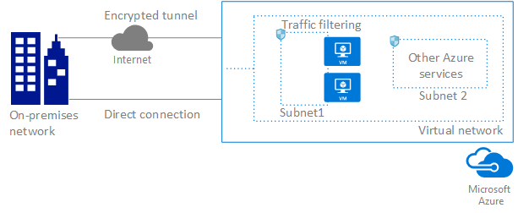
Azure Virtual Network
The Azure Virtual Network service enables you to securely connect Azure resources to each other with virtual networks (VNets). A VNet is a representation of your own network in the cloud. A VNet is a logical isolation of the Azure cloud dedicated to your subscription. You can also connect VNets to your on-premises network.

Slide 83
Isolation: VNets are isolated from one another.
Internet connectivity: All Azure Virtual Machines (VM) and Cloud Services role instances connected to a VNet have access to the Internet, by default. You can also enable inbound access to specific resources, as needed.
Azure resource connectivity: Azure resources such as Resource Group and VMs can be connected to the same Vnet. Azure provides default routing between subnets, VNets, and on-premises networks.
VNet connectivity: VNets can be connected to each other.
On-premises connectivity: VNets can be connected to on-premises networks.
Traffic filtering: VM and RG role instances network traffic can be filtered inbound and outbound by source IP destination IP address , port and protocol.

Slide 84
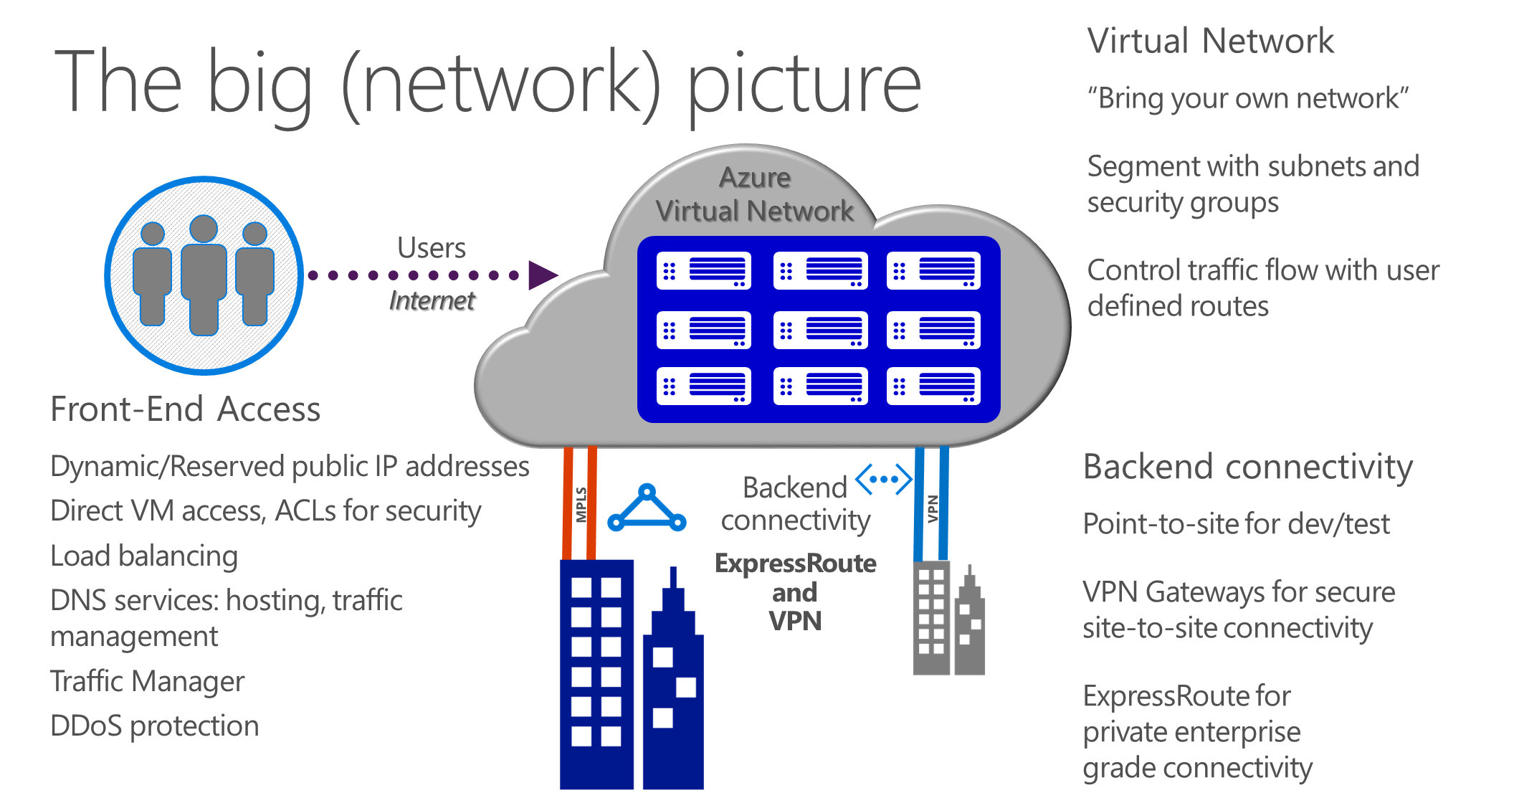
Notes:
Title: The big (network) picture
Notes:
Azure provides the right connectivity for all scenarios. From scalability entry points all over the world; to Virtual Software Defined Networks in Azure; and VPN or MPLS connections which make the Microsoft Network just another WAN site. Microsoft is ready.

Slide 85



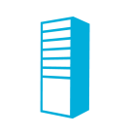
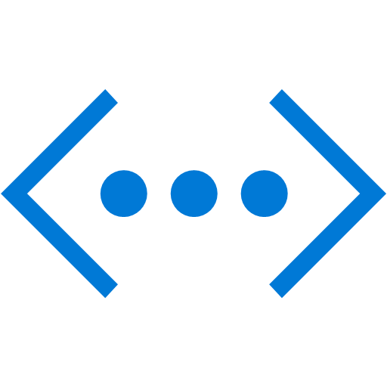
Virtual networks
On-premises
10.0/16
Internet
Bring your own network
Create subnets with your private or public IP addresses
Bring your own DNS or use Azure-provided DNS
Hybrid connectivity with VPNs and/or ExpressRoute
Direct Internet
connectivity
VPN and
ExpressRoute
Azure
VPN GW
Backend
10.3/16
Mid-tier
10.2/16
Frontend
10.1/16
AD / DNS
Virtual Network
Notes:
Title: Virtual network
Notes:
Virtual machines are able to connect across cloud services as long as they are in the same virtual network.

Slide 86
Components of a virtual network
Address spaces (IP prefixes)
The range of IP addresses available in your virtual network
Subnets
Named ranges of addresses assignable to virtual machines and cloud service instances
DNS servers
References to DNS servers that will be assigned to virtual machines or cloud service instances in the virtual network
Local network configuration
Configuration of an on-premises network connected by a site-to-site VPN connection or ExpressRoute
Notes:
Title: Components of a Virtual Network

Slide 87

Azure virtual networks and subnets
Logical isolation with control over network
Create subnets with your private IP addresses
Stable and persistent private IP addresses
Bring your own DNS
Use Azure-provided DNS
Secure VMs with input endpoint ACLs and Network Security Groups (NSGs)
Microsoft Azure
<subnet X>
<subnet Y>
<subnet Z>
<subnet X>
<subnet Y>
<subnet Z>
DNS Server
Virtual Network
Notes:
Title: Azure Virtual Networks & Subnets

Slide 88
VIP (Virtual IP address)
A public IP address belongs to the a machine in a virtual network. It also serves as an Azure Load Balancer which tells how network traffic should be directed before being routed to the VM.
It is possible to reserve an IP from the Microsoft pool
DIP (Dynamic IP address):
An internal IP assigned by Microsoft Azure DHCP to the VM
Associated automatically with the VM when created
It is released when VM is deleted or deallocated (default)
It is possible to configure and static IP address
You can have more than one DIP per VM (Multi-NIC support)
ILPIP (Instance Level Public IP)
A ILPIP is associated with the VM in addition to the VIP. Traffic to the ILPIP goes directly to the VM and is not routed through the Azure Load Balancer
Notes:
VIP: The VIP is allocated at random from a pool of IP addresses managed by Microsoft. However, it is possible to reserve an IP address from the Microsoft pool and allocate that reserved IP address as a VIP. There is a limit of 5 reserved IPs for a subscription. Unless a reserved IP address is used, the VIP is given up and returned to the Microsoft pool once the last VM with that VIP is deallocated or deleted. Internet-bound traffic coming from the VM is SNATted to have the VIP be its source address.
DIP: This IP address is associated automatically with the VM when it is created and remains associated with it while it is deployed. The DIP survives system reboots as well as service healing migration of the VM. If the VM is deleted or changed into a stopped/deallocated state it loses its DIP, which may then be allocated to another VM. Alternatively, the DIP can be a static IP address allocated to the VM on creation. This address comes from the range configured for the subnet the VM is deployed into. It is a good practice to use a distinct subnet for statically-allocated DIPs to avoid the possibility of collision between a dynamically and statically allocated DIP.
PIP: A PIP is a public instance-level IP address associated with the VM in addition to the VIP. Traffic to the PIP goes directly to the VM and is not routed through the Azure Load Balancer. Internet-bound traffic from a VM with a configured PIP is also sent over the PIP rather than going through the VIP. The PIP must be appropriately firewalled to restrict traffic to only that desired. A PIP is useful for workloads such as passive FTP that require a large number of ports to be opened, which is impractical when using the VIP which supports only a limited number of endpoints.

Slide 89

Internet IP addresses and load balancing
Public IP addresses in Azure
Can be used for instance (VM) level access or load balancing
Instance-level IP
Internet IP assigned exclusively to single VM Entire port range accessible by default
Primarily for targeting a specific VM
Load balanced IP (VIP)
Internet IP load balanced among one or more VM instances
Allows port redirection
Primarily for load balanced, highly available, or auto-scale scenarios
Internet
151.2.3.4 (VIP)
LB
131.3.3.3
(Instance-level IP)
131.3.4.4
(Instance-level IP)
VM1
VM2
IP1
IP2
Microsoft Azure

Slide 90
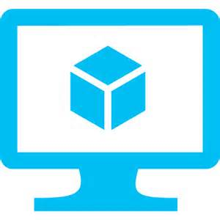
Reserved IPs
Internet
Retain your IP addresses
IPs on existing services can be reserved
IPs can be moved between services in seconds
Reserved IP
Azure Load Balancer
Reserved IP Moves
Cloud Service 1
Cloud Service 2

Slide 91
DNS names for public IP
FQDN access to a virtual machine
Available for virtual machines and web/worker roles
Automatic DNS registration/de-registration during scale-up, scale-down
Internet
Webrole.1.contoso.cloudapp.net 130.26.5.120
Webrole.0.contoso.cloudapp.net 130.26.10.80
Contoso App with two virtual machines
VM Instance 1
VM Instance 2

Slide 92

DNS Services
Azure DNS
Traffic Manager
DNS
Host your DNS domains in Azure
Integrate your Web and Domain hosting
Globally route user traffic with flexible policies
Enable best-of-class end to end user experience
Notes:
Title: DNS Services
Notes:
Azure Traffic Manager gives you three traffic routing methods to choose from: failover, performance, or weighted round robin. You choose the one that’s right for your application or scenario.

Slide 93
Virtual networks and services
DNS
Option 1: Azure provides host name resolution for VMs and role instances that reside in the same cloud service by using host names, and between VMs and role instances in different cloud services that reside on the same virtual network by using FQDNs.
Option 2: BYOD DNS use your on-premises DNS servers.
Option 3: Deploy a DNS server in Windows Azure.
Option 4: Use public DNS services.

Slide 94

Multiple NICs in Azure VMs
Up to 16 NICs per VM
NSG and routes on all NICs
Can separate front end, back end, and management
Virtual Machine
NIC2
NIC1
Default
10.3.3.33
10.2.2.22
10.1.1.11
Virtual Network
VIP 133.44.55.66
Internet
Backend
Subnet
Mgmt
Subnet
Frontend
Subnet

Slide 95
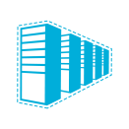

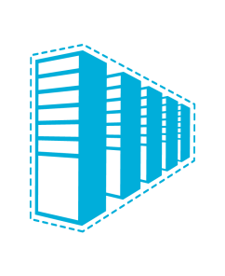


Connectivity options and hybrid offerings
Cloud
Customer
Segment and workloads
Consumers
Access over public IP
DNS resolution
Connect from anywhere
Internet connectivity
Developers
POC efforts
Small scale deployments
Connect from anywhere
Secure point-to-site connectivity
SMB, Enterprises
Connect to Azure compute
Secure site-to-site
VPN connectivity
SMB and Enterprises
Mission critical workloads
Backup/DR, media, HPC
Connect to all Azure services
ExpressRoute private connectivity
Notes:
Title: Connectivity options and hybrid offerings

Slide 96
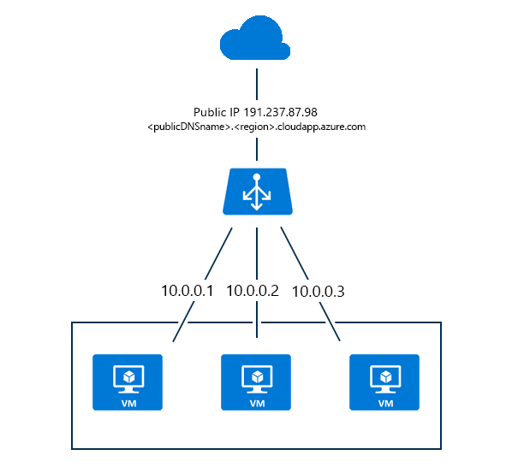
Azure Load Balancer
Azure Load Balancer delivers high availability and network performance to your applications. It is a Layer 4 (TCP, UDP) load balancer that distributes incoming traffic among healthy instances of services defined in a load-balanced set
1.Internet-facing load balancing: Load balance incoming Internet traffic to virtual machines.

Slide 97
Front-end IP configuration - contains public IP addresses for incoming network traffic.
Back-end address Pool - contains network interfaces (NICs) for the virtual machines to receive network traffic from the load balancer.
Load balancing rules - contains rules mapping a public port on the load balancer to port in the back-end address pool.
Inbound NAT Rules - contains rules mapping a public port on the load balancer to a port for a specific virtual machine in the back-end address pool.
Probes - contains health probes used to check availability of virtual machines instances in the back-end address pool.
2.Internal load balancing: An Azure internal load balancer (ILB) provides network load balancing between virtual machines that reside inside a cloud service, or a virtual network with a regional scope

Slide 98
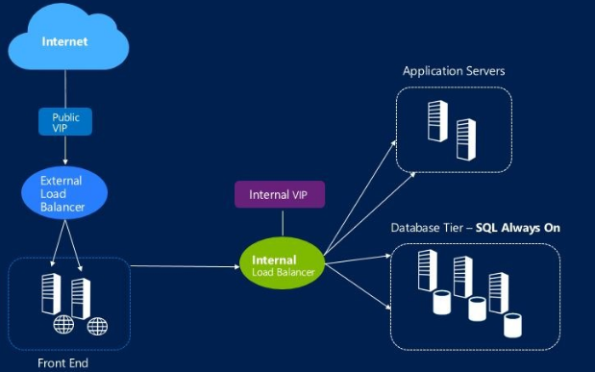
Front end IP configuration - will configure the private IP address for incoming network traffic Backend address pool - will configure the network interfaces which will receive the load balanced traffic coming from front end IP pool Load balancing rules - source and local port configuration for the load balancer. Probes - configures the health status probe for the Virtual Machine instances. Inbound NAT rules - configures the port rules to directly access one of the Virtual Machine instances.

Slide 99
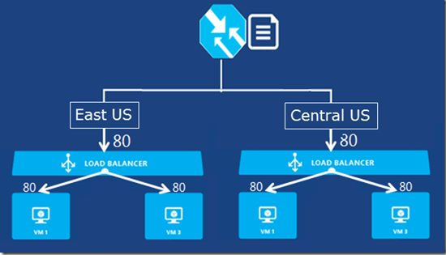
Traffic Manager
Traffic Manager balances the traffic load of services hosted in Azure. The routing policy is defined by the client and traffic to the services hosted in Azure is redirected according to set policies. Traffic manager is a DNS-based service. Thus, it will improve the availability and performance applications
Traffic Manager uses the Domain Name System (DNS) to direct client requests to the most appropriate endpoint based on a traffic-routing method and the health of the endpoints
Notes:
End points: Virtual machine on same cloud can communicate to each other automatically. But in case we need them to communicate with our own computer, we will need an endpoint configured to make it happen.

Slide 100
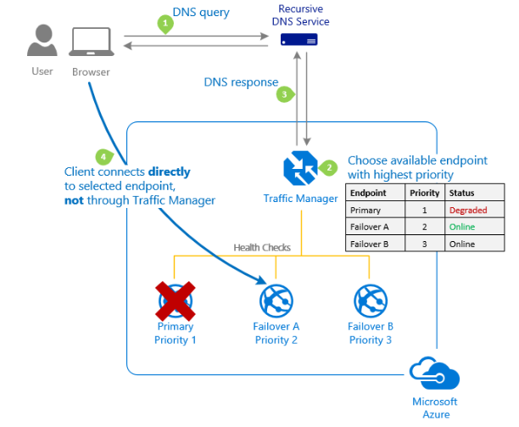
Traffic Manager Rules
Priority: Select Priority when you want to use a primary service endpoint for all traffic, and provide backups in case the primary or the backup endpoints are unavailable.

Slide 101
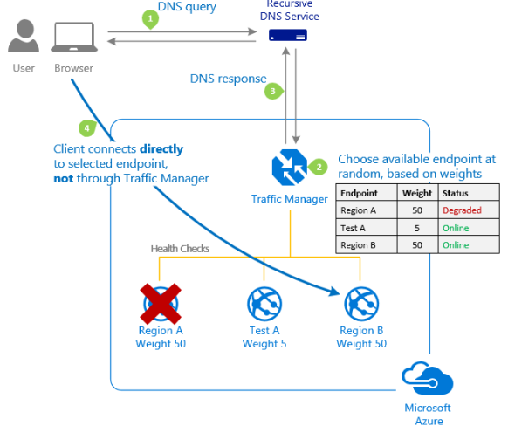
Weighted: Select Weighted when you want to distribute traffic across a set of endpoints, either evenly or according to weights, which you define.
Notes:
Ex:
Gradual application upgrade: Allocate a percentage of traffic to route to a new endpoint, and gradually increase the traffic over time to 100%.
Application migration to Azure: Create a profile with both Azure and external endpoints. Adjust the weight of the endpoints to prefer the new endpoints

Slide 102
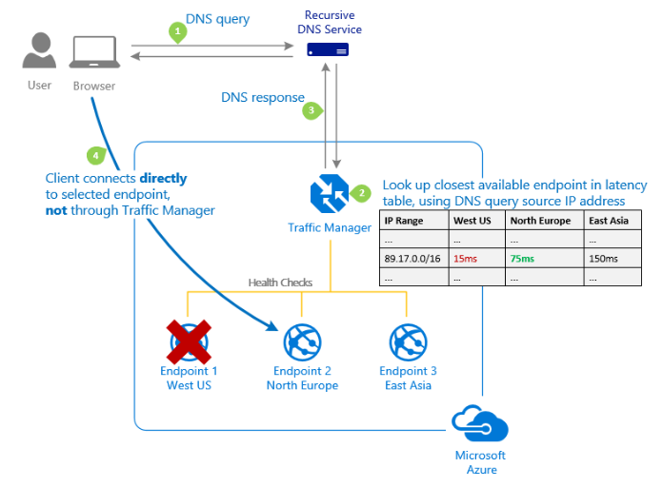
Performance: Select Performance when you have endpoints in different geographic locations and you want end users to use the "closest" endpoint in terms of the lowest network latency.
Notes:
The 'closest' endpoint is not necessarily closest as measured by geographic distance. Instead, the 'Performance' traffic-routing method determines the closest endpoint by measuring network latency.
Traffic Manager looks up the source IP address of the incoming DNS request in the Internet Latency Table.

Slide 103
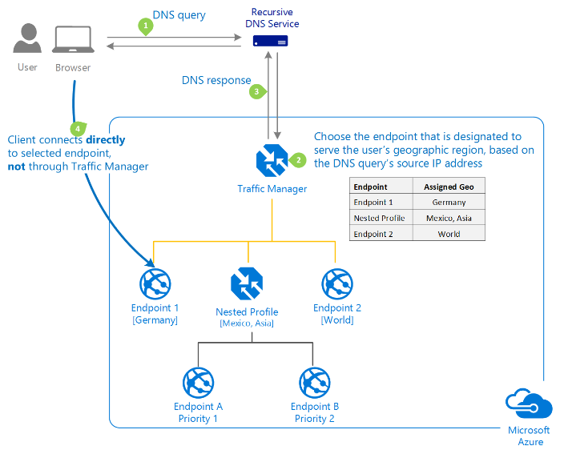
Geographic: Select Geographic so that users are directed to specific endpoints (Azure, External, or Nested) based on which geographic location their DNS query originates from. This empowers Traffic Manager customers to enable scenarios where knowing a user’s geographic region and routing them based on that is important. Examples include complying with data sovereignty mandates, localization of content & user experience and measuring traffic from different regions.

Slide 104
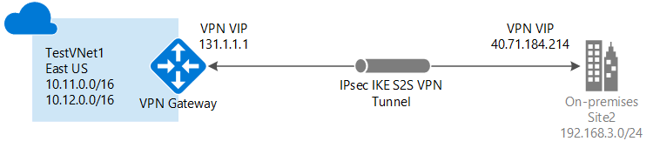
Site to Site VPN Connectivity
Using site-to-site VPN gateway can provide better continuity for your workloads in hybrid cloud setup with Azure
Before start make sure you have following in place.
1) VPN device: A VPN device is needed on-premise to create the VPN connection with Azure. A 2) Static Public IP address: The VPN device should have external public IP address and it
shouldn't be NAT.
3) Valid Azure Subscription
Notes:
IPSEC: IPSec tunnel mode is the default mode. With tunnel mode, the entire original IP packet is protected by IPSec. This means IPSec wraps the original packet, encrypts it, adds a new IP header and sends it to the other side of the VPN tunnel (IPSec peer).
Tunnel mode is most commonly used between gateways (ASA firewalls), or at an end-station to a gateway, the gateway acting as a proxy for the hosts behind it.
Network address translation (NAT) is a method of remapping one IP address space into another by modifying network address information in Internet Protocol (IP) datagram packet headers while they are in transit across a traffic routing device.

Slide 105
Site-to-Site VPN creation steps:
Create Virtual Network
Create Gateway Subnet
Create Virtual Network Gateway
Create Local Network Gateway
Create Site-to-Site VPN
Notes:
The gateway subnet The gateway subnet contains the IP addresses that the virtual network gateway services use. You need to create a gateway subnet for your VNet in order to configure a virtual network gateway
Virtual Network Gateway: A VPN gateway is a type of virtual network gateway that sends encrypted traffic across a public connection to an on-premises location. You can also use VPN gateways to send encrypted traffic between Azure virtual networks over the Microsoft network. To send encrypted network traffic between your Azure virtual network and your on-premises site, you must create a VPN gateway for your virtual network. Each virtual network can have only one VPN gateway.
A VPN gateway can take up to 45 minutes to create. This is because the VMs for the VPN gateway are being deployed to the GatewaySubnet and configured with the settings that you specified
Public IP for Local Network gateway: 86.20.250.1
Address Space : 10.7.1.0/24 Onpremise ( for an example)
Create Site-to-Site VPN
Site-to-Site VPN connection between your VPN device and the virtual network gateway. To create it,
More Services > Virtual network gateways
-------------------------------------------------------------------------------------------------------------------------
https://blogs.technet.microsoft.com/canitpro/2017/06/28/step-by-step-configuring-a-site-to-site-vpn-gateway-between-azure-and-on-premise/

Slide 106
Azure offers the following VPN gateway SKUs:
SKU | S2S/VNet-to-VNet Tunnels | P2S Connections | Aggregate Throughput Benchmark
VpnGw1 | Max. 30 | Max. 128 | 650 Mbps
VpnGw2 | Max. 30 | Max. 128 | 1 Gbps
VpnGw3 | Max. 30 | Max. 128 | 1.25 Gbps
Basic | Max. 10 | Max. 128 | 100 Mbps
Workload | SKUs
Production, critical workloads | VpnGw1, VpnGw2, VpnGw3
Dev-test or proof of concept | Basic
SKU | Features
Basic | Route-based VPN: 10 tunnels with P2S Policy-based VPN: (IKEv1): 1 tunnel; no P2S
VpnGw1, VpnGw2, and VpnGw3 | Route-based VPN: up to 30 tunnels (*), P2S, BGP, active-active, custom IPsec/IKE policy, ExpressRoute/VPN co-existence
Notes:
policy-based (static-routing) gateway, Policy-based VPNs encrypt and direct packets through IPsec tunnels based on the combinations of address prefixes between your on-premises network and the Azure VNet.
route-based (dynamic-routing) gateway: Route-based gateways implement the route-based VPNs. Route-based VPNs use "routes" in the IP forwarding or routing table to direct packets into their corresponding tunnel interfaces

Slide 107
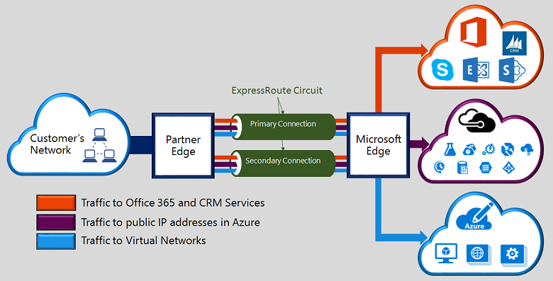
Express Route
Azure ExpressRoute enables you to create private connections between Azure data centers and infrastructure that's on your premises. ExpressRoute connections do not go over the public Internet, offering more reliability, faster speeds, lower latencies, and higher security than typical connections. In some cases, using ExpressRoute connections to transfer data between on-premises and Azure can also yield significant cost benefits.

Slide 108
With ExpressRoute, you can establish connections to Azure at an ExpressRoute location (Exchange Provider facility) or directly connect to Azure from your existing WAN network (such as a MPLS VPN) provided by a network service provider.
Express Route setup:
Create a new ExpressRoute circuit

Slide 109
Resource | Default Limit
ExpressRoute circuits per subscription | 10
ExpressRoute circuits per region per subscription for ARM | 10
Maximum number of routes for Azure private peering with ExpressRoute standard | 4,000
Maximum number of routes for Azure private peering with ExpressRoute premium add-on | 10,000
Maximum number of routes for Azure public peering with ExpressRoute standard | 200
Maximum number of routes for Azure public peering with ExpressRoute premium add-on | 200
Maximum number of routes for Azure Microsoft peering with ExpressRoute standard | 200
Maximum number of routes for Azure Microsoft peering with ExpressRoute premium add-on | 200
Notes:
ExpressRoute Limits

Slide 110
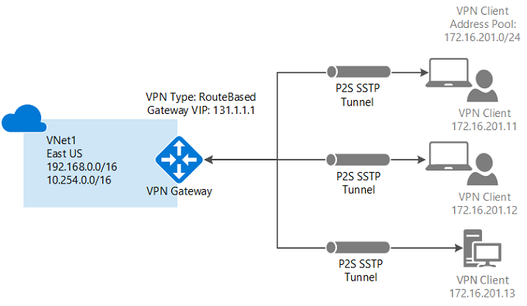
Point To Site Connection
A Point-to-Site (P2S) VPN gateway lets you create a secure connection to your virtual network from an individual client computer. Point-to-Site VPN connections are useful when you want to connect to your VNet from a remote location, such when you are telecommuting from home or a conference
Notes:
Enterprise certificate: If you are using an enterprise solution, you can use your existing certificate chain. Obtain the .cer file for the root certificate that you want to use.
Self-signed root certificate: If you aren't using an enterprise certificate solution, you need to create a self-signed root certificate

Slide 111
Point to Site Connection Steps:
Create Virtual Network
Create Gateway Subnet
Create Virtual Network Gateway
Virtual Network Gateway-Setting- Point-to-site configuration
Provide private IP address
Upload the root certificate public certificate data
Generate and install the VPN client configuration package
Notes:
Private IP: Where you want to connect ex 192.168.0.106
-------------------------------------------------------------------------
For reference
https://github.com/MicrosoftDocs/azure-docs/blob/master/articles/vpn-gateway/vpn-gateway-howto-point-to-site-resource-manager-portal.md

Slide 112
Obtain the .cer file for the root certificate
Enterprise certificate: If you are using an enterprise solution, you can use your existing certificate chain. Obtain the .cer file for the root certificate that you want to use.
Self-signed root certificate: If you aren't using an enterprise certificate solution, you need to create a self-signed root certificate.

Slide 113
Create Self Signed Certificate: From powershell
$cert = New-SelfSignedCertificate -Type Custom -KeySpec Signature `
-Subject "CN=P2SRootCert" -KeyExportPolicy Exportable `
-HashAlgorithm sha256 -KeyLength 2048 `
-CertStoreLocation "Cert:\CurrentUser\My" -KeyUsageProperty Sign -KeyUsage CertSign
Notes:
Open certificate manager in windows platform: Start->Run-> then type certmgr.msc
To obtain a .cer file from the certificate, open Manage user certificates. Locate the self-signed root certificate, typically in 'Certificates - Current User\Personal\Certificates', and right-click. Click All Tasks, and then click Export. This opens the Certificate Export Wizard.
In the Wizard, click Next. Select No, do not export the private key, and then click Next.
On the Export File Format page, select Base-64 encoded X.509 (.CER)., and then click Next.
On the File to Export, Browse to the location to which you want to export the certificate. For File name, name the certificate file. Then, click Next.
Click Finish to export the certificate. You see The export was successful. Click OK to close the wizard.
-----------------------------------------------------------------------------------------------------------------------------------------
Create self signed certificate from IIS
https://documentation.meraki.com/zGeneral_Administration/Other_Topics/Installing_a_Self-Signed_Certificate_on_Windows_Server

Slide 114
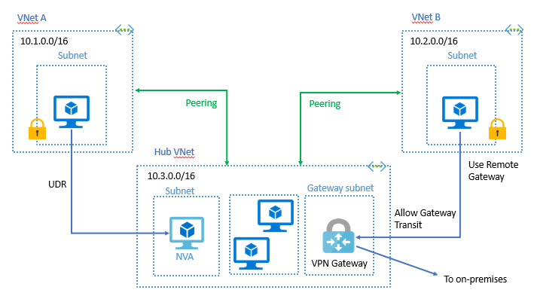
VNET Peering
Virtual network peering enables you to seamlessly connect two Azure virtual Networks. Once peered, the virtual networks appear as one, for connectivity purposes. The traffic between virtual machines in the peered virtual networks is routed through the Microsoft backbone infrastructure, much like traffic is routed between virtual machines in the same virtual network, through privateIP addresses only.
Notes:
The benefits of using virtual network peering include:
Network traffic between peered virtual networks is private. Traffic between the virtual networks is kept on the Microsoft backbone network. No public Internet, gateways, or encryption is required in the communication between the virtual networks.
A low-latency, high-bandwidth connection between resources in different virtual networks.
The ability for resources in one virtual network to communicate with resources in a different virtual network, once the virtual networks are peered.
The ability to transfer data across Azure subscriptions, deployment models, and across Azure regions (preview).
The ability to peer virtual networks created through the Azure Resource Manager or to peer one virtual network created through Resource Manager to a virtual network created through the classic deployment model. To learn more about Azure deployment models, see Understand Azure deployment models.
No downtime to resources in either virtual network when creating the peering, or after the peering is created.

Slide 115
Module 4 Azure storage

Slide 116
Microsoft Azure Storage
Cloud storage - anywhere and anytime access
Blobs, Tables, Queues and Files
Highly durable, available and massively scalable
Easily build “Internet scale” applications
More than 25 trillion stored objects
2.5+ Million requests/sec on average
Pay for what you use
Exposed via easy and open REST APIs (REpresentational State Transfer- Application Programming Interface), cross-platform client libraries and tools
Max storage account capacity | 500 TiB²
Max number of blob containers, blobs, file shares, tables, queues, entities, or messages per storage account | No limit
Notes:
Title: Microsoft Azure Storage
ZRS accounts cannot be converted LRS or GRS. Similarly, an existing LRS or GRS account cannot be converted to a ZRS account.
A REST API defines a set of functions which developers can perform requests and receive responses via HTTP protocol such as GET and POST.
Client will request to your server and then client will get response(Json/XML) from that server.
So in that response will have some structured data
Azure Storage Limit:
https://github.com/MicrosoftDocs/azure-docs/blob/master/includes/azure-storage-limits.md

Slide 117
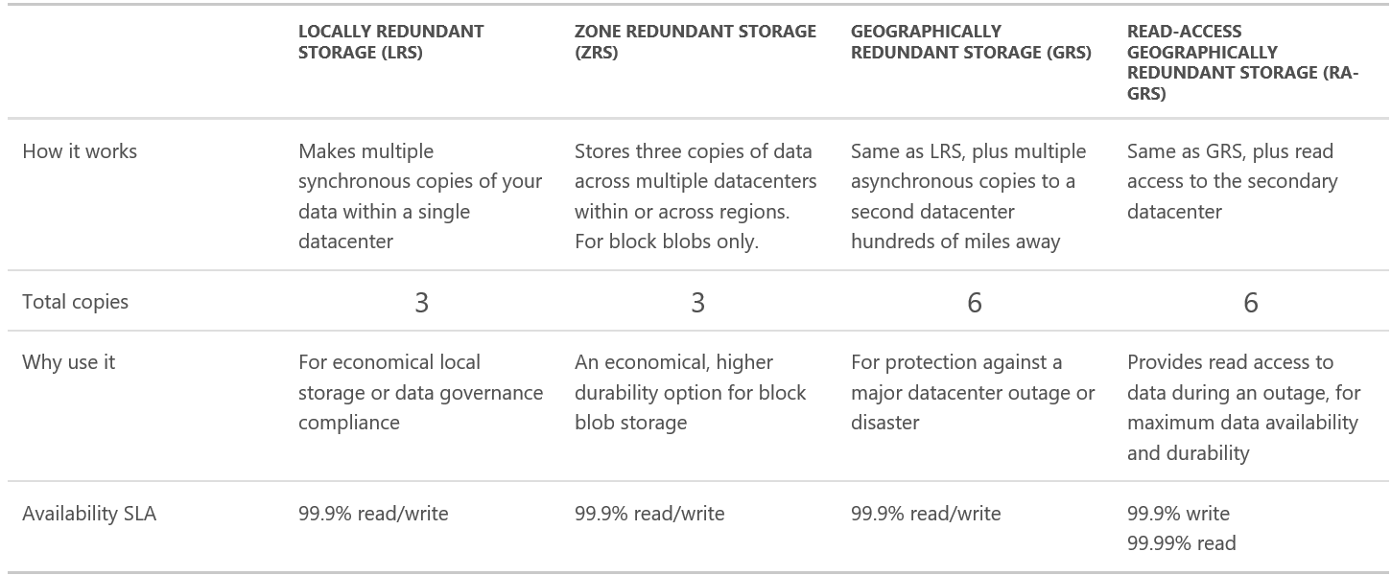
Microsoft Azure Storage: Redundancy

Slide 118
Locally redundant storage (LRS) replicates your data three times within a storage scale unit, which is hosted in a datacenter in the region in which you created your storage account. A write request returns successfully only once it has been written to all three replicas. These three replicas each reside in separate fault domains and upgrade domains within one storage scale unit.
Zone-redundant storage (ZRS) replicates your data asynchronously across datacenters within one or two regions in addition to storing three replicas similar to LRS, thus providing higher durability than LRS. Data stored in ZRS is durable even if the primary datacenter is unavailable or unrecoverable.
Geo-redundant storage (GRS) replicates your data to a secondary region that is hundreds of miles away from the primary region. If your storage account has GRS enabled, then your data is durable even in the case of a complete regional outage or a disaster in which the primary region is not recoverable.
Read-access geo-redundant storage (RA-GRS) maximizes availability for your storage account, by providing read-only access to the data in the secondary location, in addition to the replication across two regions provided by GRS
Notes:
ZRS is only available for block blobs in general purpose storage accounts, and is supported only in storage service versions 2014-02-14 and later

Slide 119
Recover Point Objective (RPO): In GRS and RA-GRS, the storage service asynchronously geo-replicates the data from the primary to the secondary location. If there is a major regional disaster and a failover has to be performed, then recent data changes that have not been geo-replicated may be lost. The number of minutes of potential data lost is referred to as the RPO (which means the point in time to which data can be recovered). We typically have a RPO less than 15 minutes, although there is currently no SLA on how long geo-replication takes.
Recovery Time Objective (RTO): This is a measure of how long it takes us to do the failover and get the storage account back online if we have to do a failover
Notes:
The time it takes us to investigate and determine if we can recover the data at the primary location or if we need to do a failover.
Failover the account by changing the primary DNS entries to point to the secondary location

Slide 120
primary and secondary region pairings
Primary | Secondary
North Central US | South Central US
South Central US | North Central US
East US | West US
West US | East US
US East 2 | Central US
Central US | US East 2
North Europe | West Europe
West Europe | North Europe
South East Asia | East Asia
East Asia | South East Asia
East China | North China
North China | East China
Japan East | Japan West
Japan West | Japan East
Brazil South | South Central US
Australia East | Australia Southeast
Australia Southeast | Australia East
India South | India Central
India Central | India South
India West | India South
US Gov Iowa | US Gov Virginia
US Gov Virginia | US Gov Texas
US Gov Texas | US Gov Arizona
US Gov Arizona | US Gov Texas
Canada Central | Canada East
Canada East | Canada Central
UK West | UK South
UK South | UK West
Germany Central | Germany Northeast
Germany Northeast | Germany Central
West US 2 | West Central US
West Central US | West US 2

Slide 121
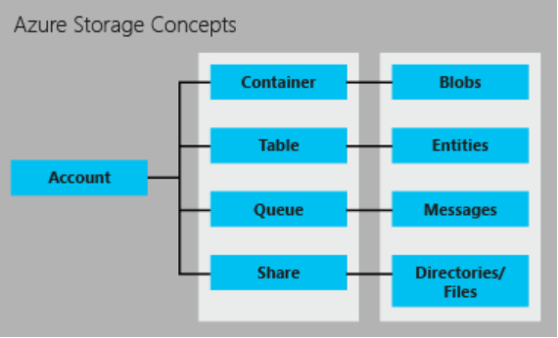
Microsoft Azure Storage: Types
Blob
Table
Queue
File
Notes:
Title: Microsoft Azure Storage: Types
Notes:
A standard storage account gives you access to Blob storage, Table storage, Queue storage, and File storage:
Blob storage stores file data. A blob can be any type of text or binary data, such as a document, media file, or application installer.
The maximum size of a block blob is therefore slightly more than 4.75 TB (100 MB X 50,000 blocks)
Table storage stores structured datasets. Table storage is a NoSQL key-attribute data store, which allows for rapid development and fast access to large quantities of data.
Queue storage provides reliable messaging for workflow processing and for communication between components of cloud services.
Follow FIFO model
File storage offers shared storage for legacy applications using the standard SMB protocol. Azure virtual machines and cloud services can share file data across application components via mounted shares, and on-premises applications can access file data in a share via the File service REST API.
Each standard storage account can contain up to 500 TB of combined blob, queue, table, and file data. See the Azure Storage Scalability and Performance Targets for details about standard storage account capacity.
SMB: Server msg block protocol, Network file sharing protocol, it follow server client architecture.

Slide 122
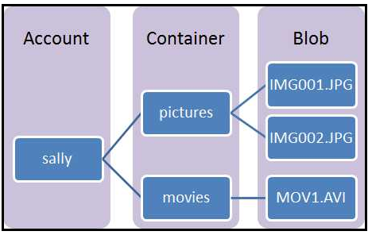
Abstractions – blobs and disks
Blobs – A Blob storage account is a specialized storage account for storing your unstructured data as blobs (objects) in Azure Storage
Massively scalable object store in the cloud
Serving images or documents directly to a browser
Storing files for distributed access
Streaming video and audio
Storing data for backup and restore, disaster recovery, and archiving
Storing data for analysis by an on-premises or Azure-hosted service
Notes:
Title: Abstractions – blobs and disks
Notes:
Azure Blobs - Provides client libraries and a REST interface that allows unstructured data to be stored and accessed at a massive scale in block blobs.
Reasons you would use Azure Blobs:
You want your application to support streaming and random access scenarios.
You want to be able to access application data from anywhere.
Azure Data Disks - Provides client libraries and a REST interface that allows data to be persistently stored and accessed from an attached virtual hard disk.
Reasons you would use Azure Data Disks:
You want to lift and shift applications that use native file system APIs to read and write data to persistent disks.
You want to store data that is not required to be accessed from outside the virtual machine to which the disk is attached.
The Azure hot storage tier is optimized for storing data that is accessed frequently. The Azure cool storage tier is optimized for storing data that is infrequently accessed and stored for at least a month.

Slide 123
Block blobs are ideal for storing text or binary files, such as documents and media files.
Append blobs are similar to block blobs in that they are made up of blocks, but they are optimized for append operations, so they are useful for logging scenarios.
Page blobs can be up to 1 TB in size, and are more efficient for frequent read/write operations. Azure Virtual Machines use page blobs as OS and data disks.
Move on-premises applications to cloud
Mounted disks are virtual hard disks (VHDs) stored in Azure Blobs

Slide 124
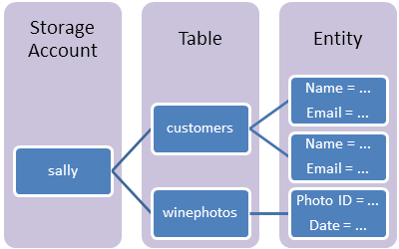
Abstractions – tables and queues
Tables –Azure Table storage stores large amounts of structured data. The service is a NoSQL datastore which accepts authenticated calls from inside and outside the Azure cloud. Azure tables are ideal for storing structured, non-relational data
Massively scalable NoSQL cloud store
Key/Attribute(s) store at scale
Auto load balances partitions to meet traffic needs
Store user, device or any type of metadata for your service
Entity: An entity is a set of properties, similar to a database row. An entity can be up to 1MB in size.
Notes:
Title: Abstractions – tables and queues
Notes:
The Queue service stores messages that may be read by any client who has access to the storage account.
A queue can contain an unlimited number of messages, each of which can be up to 64KB in size when using version 2011-08-18 or newer. For previous versions, the maximum size of a message is 8KB. Messages are generally added to the end of the queue and retrieved from the front of the queue, although first in, first out (FIFO) behavior is not guaranteed.
Tables store data as collections of entities. Entities are similar to rows. An entity has a primary key and a set of properties. A property is a name, typed-value pair, similar to a column.
The Table service does not enforce any schema for tables, so two entities in the same table may have different sets of properties. Developers may choose to enforce a schema on the client side. A table may contain any number of entities.
If you need to store messages larger than 64KB, you can store message data as a blob or in a table, and then store a reference to the data as a message in a queue.

Slide 125
Queues – Azure Queue storage provides cloud messaging between application components. In designing applications for scale, application components are often decoupled, so that they can scale independently. Queue storage delivers asynchronous messaging for communication between application components, whether they are running in the cloud, on the desktop, on an on-premises server, or on a mobile device. Queue storage also supports managing asynchronous tasks and building process work flows.
Reliable messaging system
Reliable, low latency, high throughput messaging system
Decouple components/roles
Azure one service to another service communication
Allows roles to scale independently
Implement scheduling of asynchronous tasks
Building process/work flows

Slide 126
Abstractions – files
Files – Azure File storage offers network file shares in the cloud
A PaaS solution to a network share in cloud
SMB 2.1 and 3.0 access to share data across VMs in cloud
Enables “lift & shift” of applications
Applications use native OS APIs to access files
Replace on-premises file servers
"Lift and Shift" applications
Notes:
Title: Abstractions – files
Notes:
Azure Files - Provides an SMB interface, client libraries, and a REST interface that allows easy access from anywhere to stored files.
Reasons you would use Azure Files:
You want to "lift and shift" an application to the cloud which already uses the native file system APIs to share data between it and other applications running in Azure.
You want to store development and debugging tools that need to be accessed from many VMs.

Slide 127
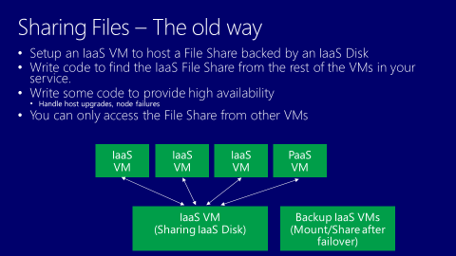
File sharing the old way in Azure
Notes:
Title: File sharing the old way in Azure

Slide 128
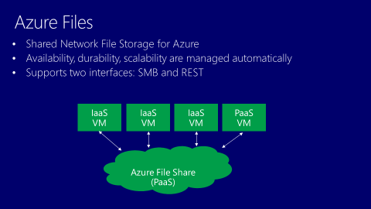
Azure files
Notes:
Title: Azure files

Slide 129
Additional services, tools and libraries
Azure Import/Export
Move TBs of data into and out of Azure Blobs by shipping disks
Submit and monitor jobs via REST and Portal
All disks encrypted with BitLocker
Tools and Libraries
Client libraries
.NET, Java, C++, Node.js, github
Windows Phone & Windows Runtime
iOS
PowerShell commands
Command line interface (CLI) tools
AzCopy – copy blobs and disks
For backups, copying between accounts, and between on-premises and cloud
Notes:
Title: Additional services, tools and libraries

Slide 130
Content Delivery Network (CDN)
The Azure Content Delivery Network (CDN) caches static web content at strategically placed locations to provide maximum throughput for delivering content to users. The CDN offers developers a global solution for delivering high-bandwidth content by caching the content at physical nodes across the world.
Benefits
Better performance and user experience for end users,
Large scaling
By distributing user requests and serving content from edge servers, less traffic is sent to the origin.

Slide 131
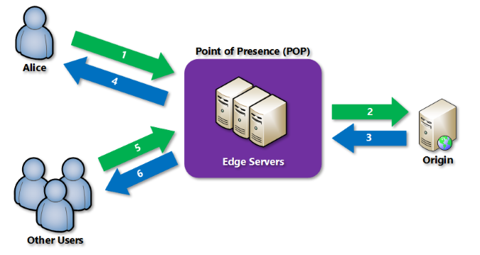
There are three Azure CDN products:
Azure CDN Standard from Akamai,
Azure CDN Standard from Verizon,
Azure CDN Premium from Verizon
You can Integrate an Azure storage account with Azure CDN
Notes:
A user (Alice) requests a file (also called an asset) using a URL with a special domain name, such as <endpointname>.azureedge.net. DNS routes the request to the best performing Point-of-Presence (POP) location. Usually this is the POP that is geographically closest to the user.
If the edge servers in the POP do not have the file in their cache, the edge server requests the file from the origin. The origin can be an Azure Web App, Azure Cloud Service, Azure Storage account, or any publicly accessible web server.
The origin returns the file to the edge server, including optional HTTP headers describing the file's Time-to-Live (TTL).
The edge server caches the file and returns the file to the original requestor (Alice). The file remains cached on the edge server until the TTL expires. If the origin didn't specify a TTL, the default TTL is seven days.
Additional users may then request the same file using that same URL, and may also be directed to that same POP.
If the TTL for the file hasn't expired, the edge server returns the file from the cache. This results in a faster, more responsive user experience.

Slide 132
Azure CDN POP Locations
Region | Verizon | Akamai
North America | Atlanta, GA, Boston, MA , Chicago, IL , Dallas, TX, Denver, CO ,Los Angeles, CA Miami, FL ,New York, NY ,Philadelphia, PA, San Jose, CA ,Seattle, WA , Washington DC | Canada Mexico United States
South America | Buenos Aires, Argentina , Rio de Janeiro, Brazil ,São Paulo, Brazil ,Valparaíso, Chile Barranquilla, Colombia ,Medellin, Colombia , Quito, Ecuador ,Lima, Peru | Argentina ,Brazil ,Chile ,Colombia ,Ecuador ,Peru ,Uruguay
Northern and Eastern Europe | Copenhagen, Denmark, Helsinki, Finland ,Warsaw, Poland Stockholm, Sweden | Bulgaria , Denmark ,Finland ,Norway ,Poland ,Sweden
Western Europe | Vienna, Austria ,Paris, France ,Frankfurt, Germany , Amsterdam, Netherlands, London, UK | Austria , Belgium ,France ,Germany ,Ireland ,Netherlands ,Switzerland United Kingdom
Southern Europe | Milan, Italy Madrid, Spain | Greece ,Italy , Portugal ,Spain
East Asia | Hong Kong ,Batam, Indonesia ,Jakarta, Indonesia, Osaka, Japan, Tokyo, Japan ,Singapore Seoul, South Korea, Kaohsiung, Taiwan | Hong Kong, Indonesia , Japan, Macau, Malaysia, Philippines, Singapore, ,South Korea ,Taiwan ,Thailand
South and Central Asia | Bangalore, India , Chennai, India , Delhi, India ,Mumbai, India ,New Delhi, India | India Sri Lanka
Middle East/West Asia | Muscat, Oman Fujirah, United Arab Emirates | Israel, Kuwait, Qatar ,Turkey, United Arab Emirates
Africa |  | Egypt, South Africa
Australia and New Zealand | Melbourne, Australia, Sydney, Australia, Auckland, New Zealand | Australia, New Zealand

Slide 133

Premium Storage
Virtual Machine
Uncached
Disk
Cached
Disk
Local
Disk
High Bandwidth with Low Latency
Up to 64 TB of storage per VM
80,000 IOPS per VM
5,000 IOPS per disk
~5 ms read/write (no cache)
Less than 1ms read latency (cache)
*Supports only Azure VM
Disk Provisioning
Disk Provisioning
SSD Provisioning
Cache Miss
Cache Hit
Server
SSD
VM/Network Provisioning
Premium Storage Blobs
Notes:
Title: Premium Storage
Notes:
Azure Premium Storage delivers high-performance, low-latency disk support for VMs running I/O-intensive workloads. VM disks that use Premium Storage store data on solid state drives (SSDs). You can migrate your application's VM disks to Azure Premium Storage to take advantage of the speed and performance of these disks.
An Azure VM supports attaching several Premium Storage disks, so that your applications can have up to 64 TB of storage per VM. With Premium Storage, your applications can achieve 80,000 IOPS (input/output operations per second) per VM and 2000 MB per second disk throughput per VM with extremely low latencies for read operations.

Slide 134
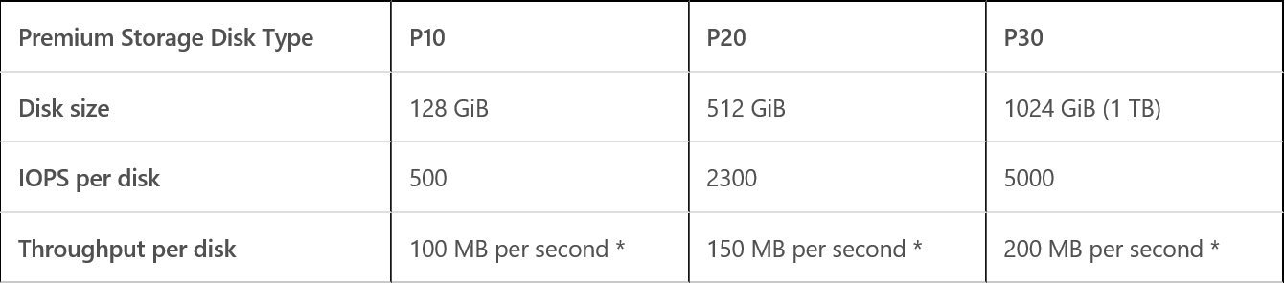
Premium Storage Scalability and Performance
Notes:
Title: Premium Storage Scalability and Performance
Notes:
Azure maps the disk size (rounded up) to the nearest Premium Storage Disk option as specified in the table. For example, a disk of size 100 GiB is classified as a P10 option and can perform up to 500 IO units per second, and with up to 100 MB per second throughput. Similarly, a disk of size 400 GiB is classified as a P20 option, and can perform up to 2300 IO units per second and up to 150 MB per second throughput.
The input/output (I/O) unit size is 256 KB. If the data being transferred is less than 256 KB, it is considered a single I/O unit. The larger I/O sizes are counted as multiple I/Os of size 256 KB. For example, 1100 KB I/O is counted as five I/O units.
The throughput limit includes writes to the disk as well as reads from that disk that are not served from the cache. For example, the sum of non-cache reads and writes should be smaller or equal to 100 MB per second for a P10 disk. Similarly, a single P10 disk can have either 100 MB per second of non-cache reads or 100 MB per second of writes, or 60 MB per second of reads with 40 MB per second of writes as an example.
When you create your disks in Azure, select the most appropriate Premium Storage disk offering based on the needs of your application in terms of capacity, performance, scalability, and peak loads.

Slide 135
Module 5 Identity in Microsoft Azure

Slide 136
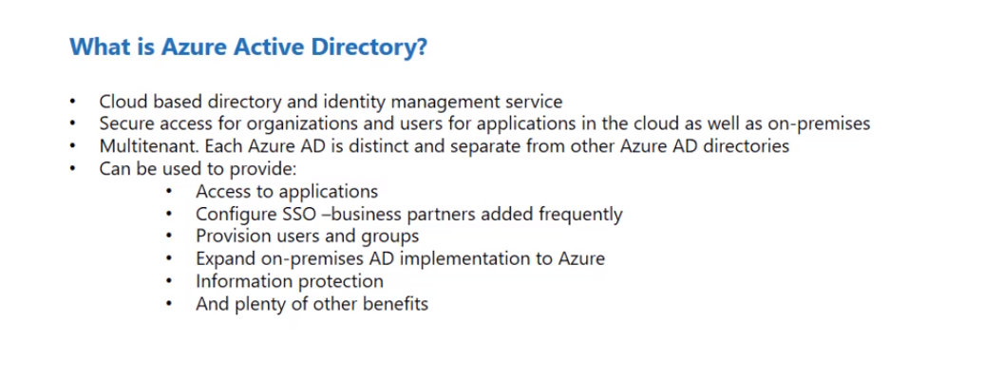

Slide 137
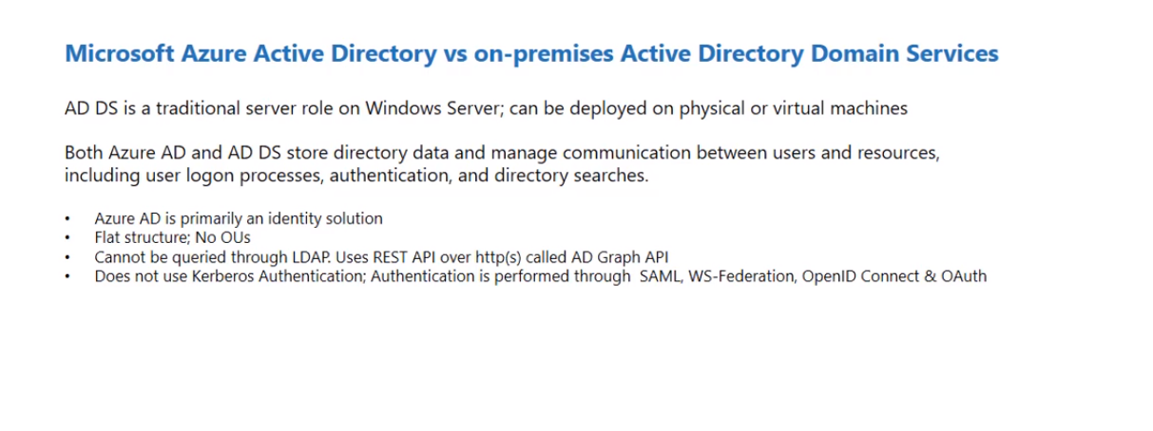

Slide 138
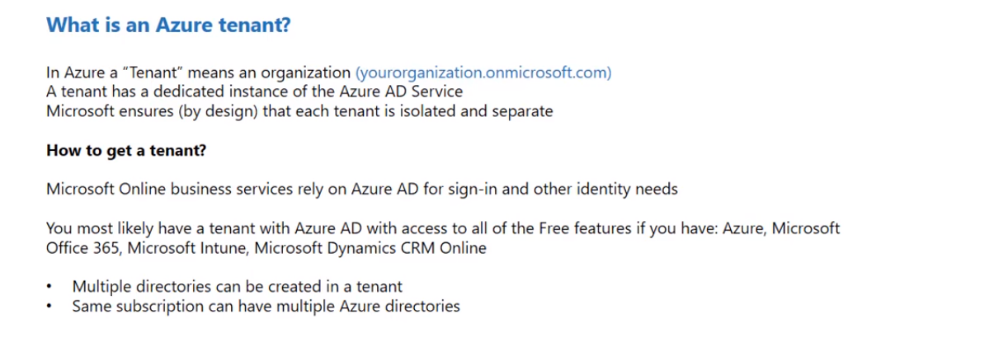
Notes:
Tenant-Logical Container, Whenever you create a Azure Tenant it will come with default AD service

Slide 139
Microsoft Azure Active Directory Editions
Azure Active Directory Free Edition
Azure Active Directory Basic
Azure Active Directory Premium p1
Azure Active Directory Premium p2
https://azure.microsoft.com/en-in/pricing/details/active-directory/

Slide 140
Azure AD Lab- Azure AD Users and Group
Create a User
Login to portal as User

Slide 141

Azure AD – Custom Domains

Slide 142

Azure AD Lab-Custom Domain
Notes:
ethanstechnologies.tk

Slide 143

Notes:
https://docs.microsoft.com/en-us/powershell/azure/active-directory/install-msonlinev1?view=azureadps-2.0
Install-Module AzureAD
Connect-AzureAD
Get-MsolUser
New-MsolUser -UserPrincipleName “<UserName>@<Yourtenant>.onmicrosoft.com"

Slide 144

Azure AD Lab-Custom Directory

Slide 145

Azure AD Lab-Custom Directory

Slide 146

Azure AD Enterprise application integration
Notes:
Extension needs to install

Slide 147

Azure AD Enterprise application integration

Slide 148
Identity in the past
On-premises
Authentication Mechanisms
Kerberos
Negotiate
AD
NTLM
Secure Channel
Digest
Notes:
During previous years of identity management, we deployed an on-premises Active Directory domain which supported common authentication mechanisms such as Kerberos, Negotiate, NTLM, Secure Channel and Digest. Going forward and moving towards the cloud, we will see that these authentication mechanisms are less useful to us because the currency of cloud computing these days is federation. Federation sign in protocols such as WS-Fed, SAML and OAuth allow us to scale across multiple authentication domains. You can think of a federation between two organization's like the watered down version of an Active Directory trust between two domains.

Slide 149
Identity today
On-premises
Cloud
Hybrid
Federation
Kerberos
AAD
AAD
AAD
Negotiate
NTLM
SChannel
Digest
Sync with
pwd hashes
Sync with/without
pwd hashes
AD
WS-Fed
AD
Federation
AD
SAML
OAuth
Notes:
This slide describes the four main possible ways in which an organization may deploy on-premises AD, Azure AD and the tools linking them.
On-premises only means there is no Azure AD at all. All STS infrastructure is on-premises. This may limit access to the organization’s identity infrastructure to only the simpler passive redirection protocols. In particular, Office 365 is not supported by such deployment.
On the other extreme is the Azure AD only deployment. This is particularly appropriate for small organizations, with no on-premises identity infrastructure but still wanting to manage their own users and their access to 3rd party applications.
The other two options involve both on-premises and Azure AD identity infrastructure and the AAD Connect (sync) process that synchronizes some or all user from on-premises to AAD. Optionally, the sync can also copy hashes of user passwords. That latter option allows the organization to decide where the users authenticate (on-premises or cloud) and change that setting fairly rapidly (in case, for example one the environments becomes unavailable).
There are some other variations on the above scenarios, e.g. allowing user’s to reset their passwords in AAD and have that synced back to on-premises.

Slide 150
AD in Microsoft Azure IAAS
Why Deploy AD in Microsoft Azure IaaS
Geo-location authentication services for locations without on-premises data centers
Backup/disaster recovery site
Network applications deployed in Microsoft Azure that require AD, like SharePoint
For Azure applications that require a Windows domain
Notes:
AD = Windows Azure Active Directory

Slide 151





Windows Server Active Directory in the Cloud
Leverage cloud platforms to run Windows Server Active Directory and Active Directory Federation Services to reduce infrastructure on-premises.
Manage Active Directory using Windows PowerShell, use the improved deployment experience and leverage the Active Directory Administrative Center for centralized management
Developers can integrate applications for single sign-on across on-premises and cloud-based applications.
Infrastructure Services
Files
Web Apps
LOB Apps
Activate clients running Office on at least Windows 8 or Windows Server 2012 automatically using existing Active Directory infrastructure.
Run Active Directory at scale with support for virtualization and rapid deployment through domain controller cloning.
Active Directory
Notes:
This slide gives an overall view of the capabilities of AD in IaaS
<clockwise view>
We have PowerShell capabilities that can be used to maintain AD on the IaaS machine
Allow Cloud hosted apps that need to use Windows Authentication to have a local source for a Windows Domain
Allow apps to be integrated for Single-sign on with Cloud apps
Allow activation of Office clients (or Win8/Svr2012)
Provides the ability to scale out Active directory using multiple IaaS machine

Slide 152
Considerations for Virtualized DCs Running in Microsoft Azure IAAS
A Virtual Machine (VM) can use either a static or dynamic IP address
DCPromo will “complain” about the dynamic IP, but the warning can be discarded
Virtual Private Network (VPN) connectivity to the on-premises network might be required
Depends on whether a new forest or existing forest is used

Slide 153
Possible Scenarios for AD in Microsoft Azure IAAS
New AD forest fully contained in Microsoft Azure
No on-premises connectivity required
Used for applications that require Active Directory Domain Services (AD DS) without dependencies on corporate resources
No Single Sign On (SSO) with corporate credentials
Minimum to no egress traffic related to AD DS
Extension of the on-premises AD DS deployment in Microsoft Azure
Can be replica DCs of an existing domain in the corporate forest or a new domain in the corporate forest
Applications can access corporate directory data
Requires VPN connectivity to the corporate network
Provides SSO with corporate credentials

Slide 154
Design Considerations for Traffic and Costs
Design should:
Try to minimize egress (outgoing) traffic
Microsoft Azure charges for egress traffic, not ingress traffic
Consider that Microsoft Azure does provide communication between different virtual networks
Common AD physical design concepts, such as sites, subnets, site links costs and intervals, still apply
The DCs in Microsoft Azure should be part of a new site
Subnets should be created and linked to the site that includes the subnets defined in the virtual network
It is a best practice to create this network configuration before DCs are added to Microsoft Azure

Slide 155
Design Considerations for Traffic and Costs (continued)
Site link cost from the on-premises site to the Microsoft Azure site should be high enough to prevent on-premises clients from going to the Microsoft Azure site as a failback
Also, any next closest site DC Locator from the on-premises clients should avoid using the site in Microsoft Azure
DCs in Microsoft Azure should not be used as a lag site
Replication should be as infrequent as possible
Do not use change notifications in the site link to the Microsoft Azure site
If possible, use more “aggressive” compression algorithms of the replication traffic
Notes:
Understanding Site link cost
http://technet.microsoft.com/en-us/library/cc784142(v=WS.10).aspx
Understanding AD sites
http://technet.microsoft.com/en-us/library/cc782048(v=WS.10).aspx
Replication Between Sites
http://technet.microsoft.com/en-us/library/cc759160(v=ws.10).aspx
Compression of Replication data
http://technet.microsoft.com/en-us/library/cc755994(v=WS.10).aspx
For more information on compression of the replication traffic, see: http://technet.microsoft.com/en-us/library/cc755994(v=WS.10).aspx
[EDITOR] TWB_Trevor:
09 October 2013 What are these numbers? Kindly delete if they have been added here by accident.

Slide 156
Introduction Azure Active Directory
What Microsoft Azure AD is Not
Windows Server AD in Microsoft Azure is not Microsoft Azure AD!
Microsoft Azure AD is not AD deployed and used in Microsoft Azure Virtual Machine
If you need AD in Microsoft Azure Virtual Machine, then refer to the previous section of this module
Notes:
AAD Device registration https://msdn.microsoft.com/en-us/library/azure/dn903763.aspx

Slide 157




Azure Active Directory
Easily add custom cloud-based apps. Facilitate developers with identity management.
Your Apps
PowerShell
LDAP v3
Sync identity or provide federated identity for single sign-on
SQL
Web Services
(ODBC)
(SOAP, JAVA, REST)
SaaS Apps
Choose among hundreds of popular SaaS apps from a pre-populated application gallery.
Active Directory
Active Directory
* Multi-Factor
Authentication
* Application Proxy
Add multi-factor authentication for additional user identity verification
Comprehensive cloud based identity and access management combining directory services, identity governance, application access management and a developer’s identity management platform
Administrators have access to security reporting that tracks inconsistent access patterns and view users who signed in from unknown sources
Notes:
This slide provides an overall view of Azure AD capabilities
<clockwise view – beginning with Powershell>
Ability to administer AAD using PS
Ability to sync identity or provide federated identity for SSO
Add the additional capability, built in multi-factor authentication
Ability to allow identity for true Cloud based apps
Added security reporting for inconsistent access patterns, infected devices etc
Identity governance
Application Proxy - http://www.identityandcloud.com/2014/11/a-quick-intro-to-azure-ad-application-proxy/

Slide 158
Problem Statement
Traditional directories do not work well with cloud workloads
The protocols (LDAP, Kerberos, etc.) were never planned to be widely accessible through the Internet
New authentication protocols (OAuth2, OpenID Connect etc.) which are widely adopted and more scalable are taking over
With the advent of new heterogeneous devices and operating systems, the connection to the directory is not permanent (as it could be with a traditional laptop/desktop computer)
There is an obvious need for widely interoperable authentication/authorization protocol (heterogeneous OS)
The presence of multiple authentication systems in the applications themselves breaks the SSO consolidation that has taken place across the last few years
Notes:
There is an obvious need for a widely interoperable authentication/authorization protocol (heterogeneous OS)
This comes from the fact that we have a heterogeneous OS (mainly because of IT consumerization and Bring Your Own Device (BYOD)) and a solution based on one OS is not suitable anymore. Therefore, a widely adopted standard is required, such as OAuth2 and OpenID Connect.
The number of authentication systems that are built into applications themselves break the Single Sign On (SSO) consolidation that has taken place these last few years.
Applications in the cloud tend to implement their custom authentication mechanisms. This leads to a hassle for password management. More passwords mean a higher likelihood of weaknesses in the password management process.

Slide 159

What is Microsoft Azure AD?
A multi-tenant directory in the cloud
Extension of AD into the cloud
Designed primarily to meet the needs of cloud applications
Identity as a service: an essential part of Platform as a Service

Slide 160
Why Use Microsoft Azure AD?
Central management of the entities shared between the different cloud applications in the organization
Allows connecting to the Cloud directory from any platform with any device
Allows identities to be shared with a third-party cloud application
Implement widely adopted authentication/authorization protocols
SaaS directory for small orgs with no identity infrastructure

Slide 161
Azure Active Directory Editions - Free
Manage user accounts
Synchronize with on-premises directories
Get single sign-on across Azure, Office 365, and thousands of SaaS applications
Notes:
Find more details at https://msdn.microsoft.com/en-us/library/azure/dn532272.aspx

Slide 162
Azure Active Directory Editions - Basic
Company branding – Add your company logo and color schemes to your organization’s Sign In and Access Panel pages
Group-based application access – Use groups to provision users and assign user access in bulk to thousands of SaaS applications
Self-service password reset – Give all users in your directory the capability to reset their password, using the same sign in experience they have for Office 365.
Enterprise SLA of 99.9% - At least 99.9% availability of the Azure Active Directory Basic service.
Azure Active Directory Application Proxy - Publish on-premises web applications using Azure Active Directory
Notes:
Find more details at https://msdn.microsoft.com/en-us/library/azure/dn532272.aspx

Slide 163
Azure Active Directory Editions - Premium
Self-service group management - Enables users to create groups, request access to other groups, delegate group ownership so others can approve requests and maintain their group’s memberships
Advanced security reports and alerts – View detailed logs showing more advanced anomalies and inconsistent access pattern reports
Multi-Factor Authentication – MFA can help secure access to on-premises applications, Azure, Microsoft Online Services like Office 365 etc
Microsoft Identity Manager (MIM) - Grant rights to use a MIM server (and CALs) in your on-premises network to support any combination of Hybrid Identity solutions
Enterprise SLA of 99.9% - At least 99.9% availability of the Azure Active Directory Premium service
Azure Active Directory Application Proxy – Provide secure access to on-premises applications like SharePoint and Exchange/OWA from the Cloud using Azure Active Directory
Password reset with write-back - self-service password reset can be written back to on-premises directories
Notes:
Find more details at https://msdn.microsoft.com/en-us/library/azure/dn532272.aspx

Slide 164
Microsoft Azure AD Design Principle
The cloud design point demands capabilities that are not part of current-day Windows Server AD
Maximize device and platform reach
HTTP/web/REST-based protocols
Multi-tenancy
Customer owns the directory, not Microsoft
Optimize for availability, consistent performance, and scale
Keep it simple

Slide 165

Azure AD Usage
Consolidate identity management across cloud apps
Connect with people from web identity providers and other organizations

Slide 166

Microsoft Azure AD Protocol
Microsoft Azure Active Directory
OAuth2
SAML-P
STS
WS-Federation
Metadata
Tenant
Graph API
Interface RESTful
Notes:
As you can see the protocols supported are standard opened protocol. Think WAAD as a shared infrastructure that make available multiple interfaces which are shared between tenants.

Slide 167

Module 6: Microsoft Azure SQL

Slide 168

Notes:
Refer Microsoft site for future changes: https://docs.microsoft.com/en-us/azure/sql-database/sql-database-service-tiers
Database Transaction Units: (DTU): How much power your server is. DTUs provide a way to describe the relative capacity of a performance level of Basic, Standard, and Premium databases. DTUs are based on a blended measure of CPU, memory, reads, and writes
Collation: Database collation defines the rules that sort and compare data, and cannot be changed after database creation
How to choose plan: for example, websites with 25000 page view per day and each page view generates 2 or 3 queries then S0 plan is more than enough.

Slide 169


Notes:
SQL injection is a code injection technique, used to attack data-driven applications, in which nefariousSQL statements are inserted into an entry field for execution (e.g. to dump the database contents to the attacker)

Slide 170

Notes:
CREATE TABLE dbo.test3(a int) ;
INSERT INTO dbo.test3 VALUES (1) ;
GO
SELECT * FROM dbo.test3 ;

Slide 171


Slide 172


Slide 173
Module 7: Azure Web Apps

Slide 174


Slide 175
App Service Web Apps is a fully managed compute platform that is optimized for hosting websites and web applications. This platform-as-a-service (PaaS) offering of Microsoft Azure lets you focus on your business logic while Azure takes care of the infrastructure to run and scale your apps.
App
Service:
Azure

Slide 176
Azure Web App
Mobile
App
Logic App
App Services
Notes:
Web Apps is a fully managed compute platform that is optimized for hosting websites and web applications.
Mobile App: Use the Mobile Apps feature of Azure App Service to rapidly build engaging cross-platform and native apps for iOS, Android, Windows or Mac; store app data in the cloud or on-premises; authenticate customers; send push notifications; or add your custom back-end logic in C# or Node.js.
Logic App: LogicApps are a managed service that provides the Lego blocks of Azure serverless architecture that you can use to create, develop and deploy cloud-based integrations and workflows

Slide 177

One
price

Slide 178
Full
•
capability set available including:
.NET, Node.js, Java, PHP, and Python
•
WebJobs for long running tasks
WEB APPS
•
Integrated VS publish, remote debug…
Web apps run as-is
no changes required
•
CI with GitHub, BitBucket, VSO
•
Auto-load balance, Autoscale, Geo DR
•
Virtual networking and hybrid connections
•
Site slots for staged deployments

Slide 179
Lab 1: Publish .Net Application to Azure
1.first create a app service.
2.Go to azure SQL and create a database.
3.Go to visual studio ->create a new project->web->asp.net web application framework->MVC->click on web application and run it, build will automatically trigger.
4.Now publish this app to azure.
5.Make some changes in your code then test.

Slide 180

Lab Practice:
Install Visual Studio 2017
ASP.NET and web development
Azure development

Slide 181

Developing with .Net on Microsoft Azure
Notes:
Lab practice:
Create a SQL Database in Azure
Connect an ASP.NET app to SQL Database
Deploy the app to Azure
Update the data model and redeploy the app
Stream logs from Azure to your terminal
Manage the app in the Azure portal

Slide 182

Features: We can create multiple Web App using same App service Plan. We can scale up/down. Single Plan can run on multiple instances

Slide 183

Notes:
Website is running , now you can download this html file and using any tool , you can modify this page.

Slide 184


Slide 185

Notes:
Once successful-press F5

Slide 186


Slide 187
Lab 2: Update Application setting 1. When we want to publish the app using visual studio, visual studio will create publish profile.

Slide 188
New capabilities for Mobile apps:
• Webjobs for long running tasks
• CI with GitHub, BitBucket, VSO
• Auto-load balance, Autoscale, Geo DR
MOBILE APPS
Mobile services plus
a whole lot more
• Virtual networking and hybrid connections
Features: Integrate with SQL, Oracle, SAP, MongoDB, and etc.
Make your app work offline and sync.
Connect to on-premises data.
Leverage enterprise single sign-on with Active Directory.
Integrate with social providers like Facebook, Twitter, and Google.
Broadcast push notifications across platforms, with customer segmentation.
Gain insights with mobile analytics.
Auto-scale to millions of devices.

Slide 189
New Logic Apps for easy automation
•
No code designer for rapid creation
•
Dozens of pre-built templates to get started
•
Out of box support for popular SaaS and on-
premises apps
LOGIC APPS
Automate SaaS and
on-premises systems
•
Use with custom API apps of your own
•
Biztalk APIs for expert integration scenarios

Slide 190

Easily use cloud or custom APIs:
•
Dozens of built-in APIs for popular SaaS
•
An ecosystem of APIs for any need
•
Create and publish custom, reusable APIs
API APPS
Create, consume and
host APIs more easily
•
Visual Studio tooling with one click publish
and remote debugging
•
Automatic client SDK generation for many
languages

Slide 191

•
•
•
•
•
•
•
•
•
•
•
•
Box
Chatter Delay Dropbox
Azure HD Insight
Marketo
Azure Media Services
OneDrive SharePoint SQL Server Office 365
Oracle
•
•
•
•
•
•
•
•
•
•
•
•
QuickBooks
SalesForce Sugar CRM SAP
Azure Service Bus
Azure Storage Timer / Recurrence Twilio
Twitter
IBM DB2
Informix
Websphere MQ
• Azure Web Jobs
• Yammer
• Dynamics CRM
• Dynamics AX
• Hybrid Connectivity

Slide 192

App
Service
WEB APPS
Web apps that scale with your business
MOBILE APPS
Build Mobile apps for any
device
LOGIC APPS
Automate business process
across SaaS and on-premises
API APPS
Easily build and consume
APIs in the cloud

Slide 193



WEB AP
WEB APP
Customer site S
App Service
S LOGIC APPS MO
LOGIC APPS
Customer
Appointment
BILE APPS
MOBILE APPS
Technician App
WEB APPS
Customer site
Ser vice Advisor
API APPS
API APPS

Slide 194
Module 8: Azure Backup and Site Recovery

Slide 195


Slide 196


Slide 197


Slide 198


